Slide 1
Assignment 6
Interactive Medium-Fi Prototype

Slide 2


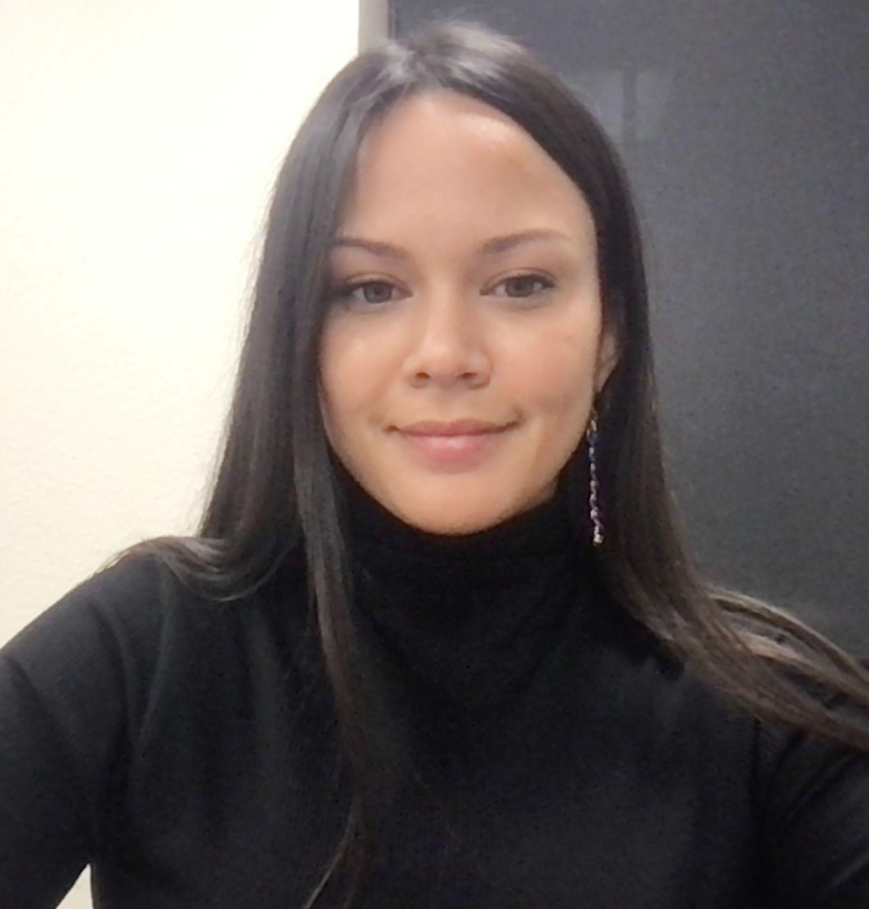
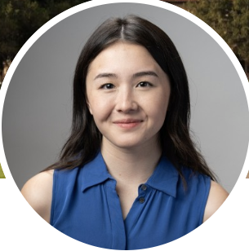

The Gloo Crew
Matthew Mattei
Junior; Computer Science
Monica Hicks
Coterm; Computer Science
Alison Rogers
Coterm; Computer Science
Justin Blumencranz
Senior; Symbolic Systems

Slide 3
Roadmap
1
5
2
6
3
7
4
8
Introduction
Revised Sketches
Values in Design
Med-fi Task Flows
Tasks
Prototype
Usability+
Appendix

Slide 4
1
Introduction
Value proposition, Problem/Solution

Slide 5
Value Proposition
“Making student-teacher connections that stick!”

Slide 6
Problem
Especially in larger schools, students feel daunted by, and disconnected from, the college application process while teachers have a hard time connecting with students and being able to advocate for them.

Slide 7
Solution
A platform for high school students and teachers who feel disconnected due to the large size of their school to easily schedule times to meet and connect with each other.
Gloo includes a journaling interface to help both students and teachers remember and reflect on their interactions for future reference and an AI algorithm based on interests and student journals to help create personalized teacher recommendations for students.

Slide 8
2
Values in Design

Slide 9
Gloo Core Design Values
Navigable
Safe
Intuitive movement
Keep students from harm
Accessible
Transparent
Built for inclusivity
Use of AI is clear

Slide 10
Features & Decisions
Navigable:
Prioritizing clearly labeled icons over potentially more aesthetic options.
Offering back buttons on every page not accessible from the footer bar.
Only enabling users to go 2-3 pages in from any page accessible from footer.
Safe:
Only allowing student-initiated connections to teachers.
Do not offer peer-to-peer viewing vectors to ensure student privacy.
Only allowing students and teachers associated with their own schools to make accounts.

Slide 11
Features & Decisions
Accessible:
Offer a variety of input formats (click-to-add for interests and voice-to-text for journal entries).
Changed color scheme from blue/green to red/brown to ensure viewability for lower-vision users.
Transparent:
Offering explanations of features that incorporate AI or make use of implicitly gained information (ex. Recommending teachers based on recent journal entries).
Utilizing color, icons, and Gestalt principles to make AI features/app sections readily recognizable

Slide 12
Potential Tensions
Only allowing student-initiated connections may lead to tension for teachers who wish to proactively seek students to connect with. While we understand the motivation behind this tension, we haven chosen to make the safety and privacy of students using our app one of our primary focuses.
Clearly labeling AI features and use of data may lead to tension for teachers unfamiliar with AI or users highly conscious of how their information is used. However, transparency is something we are unwilling to compromise on. We plan to provide detailed privacy statements to enable even the most data-conscious users to have full confidence in Gloo.

Slide 13
3
Tasks

Slide 14
User Tasks
 | Make a Profile | Create OHs | Journal | Find a Connection
Complexity | Simple | Complex | Moderate | Simple
Userbase | Teachers and students | Teachers | Teachers and students | Students
Changes? | Brand new! | Now on the calendar page instead of the home page | Removed teacher sorting for students and streamlined task flow | Top recommendations moved to the home page

Slide 15
4
Usability+
Usability goals and key measurements

Slide 16

Usability Goals
Navigable
We want to reduce misclicks by making the expected task flows clear to users.
Simple
We want to present an aesthetic, minimalist design.
Approachable
We want our designs to feel welcoming and our tasks to feel easily achievable.

Slide 17
Usability Goals - Rationale
Navigable
Simple
Approachable
The task flows should feel intuitive and easy to navigate. Returning to the homepage or previous page should be a single-click action.
Our app should feel clean and focused with only the necessary info displayed. Content should be quick to find and easy to digest.
Our app should feel friendly and welcoming. Users should be comfortable exploring the app regardless of prior technical ability.

Slide 18
Usability Goals - Key Metrics
Navigable
Simple
Approachable
Key Metric 1: Users should be able to complete all tasks with < 10% misclicks.
Key Metric 2: Users should be able to complete simple task flows in < 45 sec.
Key Metric 3: Users should spend < 10 sec deciding what to do next.

Slide 19
Progress Towards Usability Goals
Navigable
Simple
Approachable
Removed the large `+` button and replaced it with a uniform tile containing the most common user task.
Added back buttons to every screen except confirmation screens.
Used a muted background and accent colors to draw the user’s attention to the most important info.
Used large, simple icons to direct users through the task flow without cluttering the screen.
Selected inviting warm tones over our original plan of sterile cool tones.
Added instructional text to guide users through the task flow and minimize errors.

Slide 20
5
Revised Sketches

Slide 21
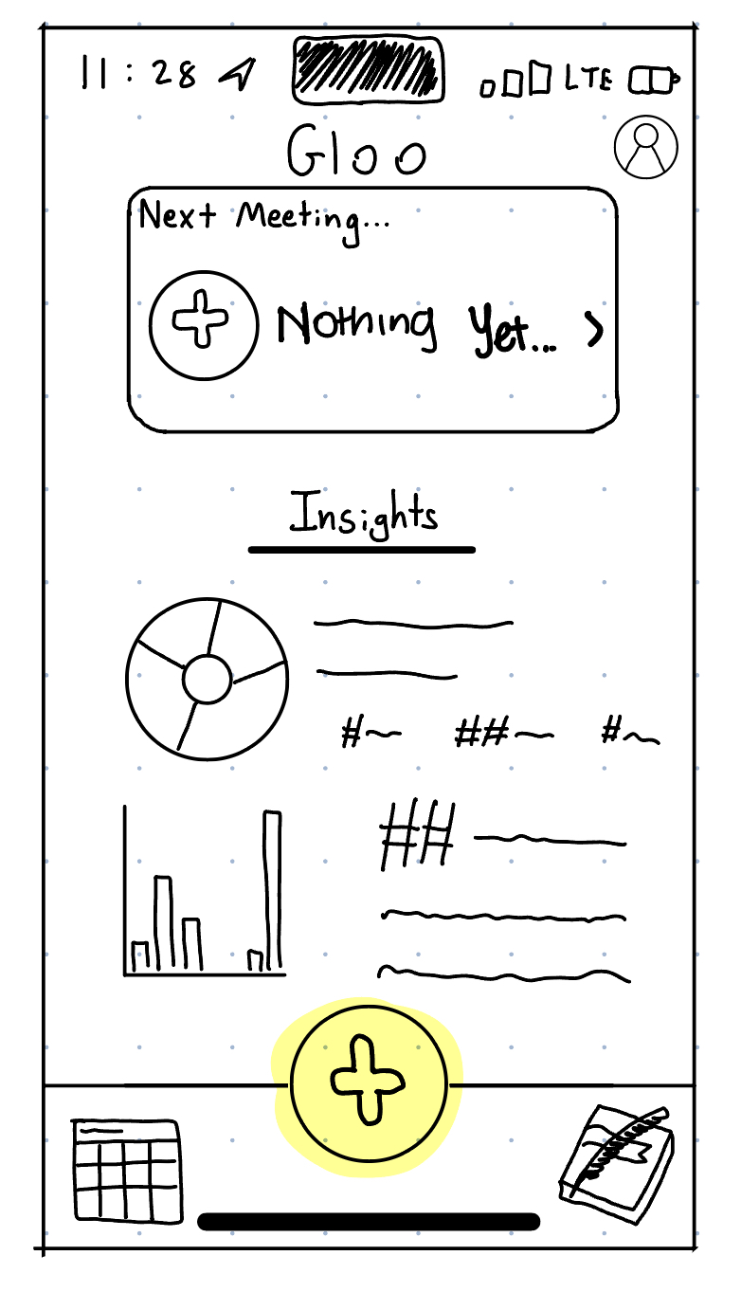
Major Change 1 - Improve Footer
Before: Teachers and students had a large `+` in the footer of each screen.
User/Studio Feedback:
Students didn’t know what the plus button meant.
Users weren’t sure if the plus button represented different actions on different pages.
Users look to the footer first when trying to decide what to do next (except for when they wish to go back).

Slide 22
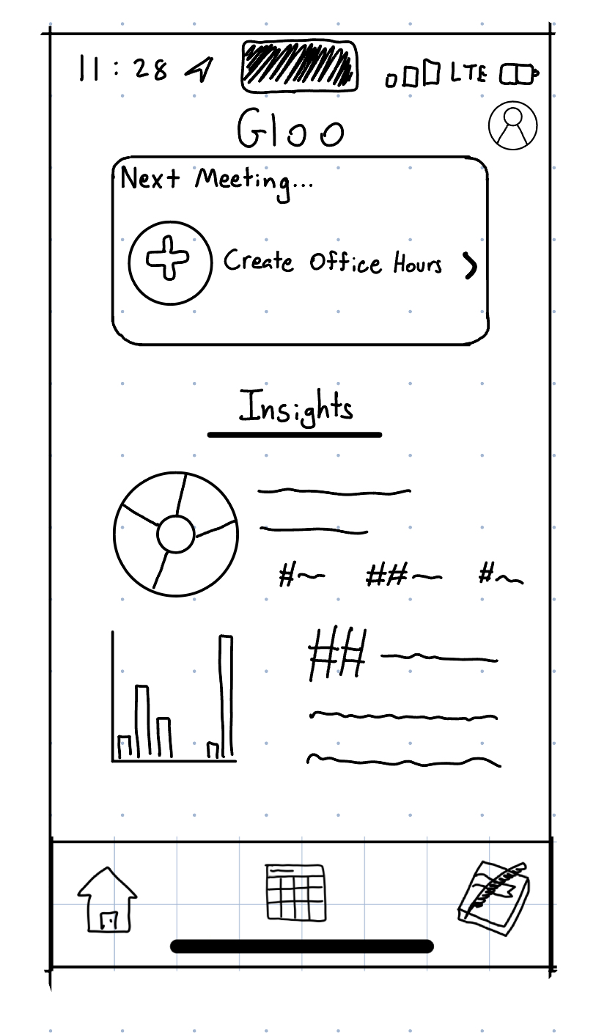
Major Change 1 - Improve Footer
After: Teachers and students have a uniform footer outlining the most common actions. Users can return home or to the two most common tasks from any page.
Progress towards usability:
Navigable: Users look for icons representing task actions.
Simple: A uniform footer reduces cognitive load for users.
Approachable: A consistent layout builds user comfort and confidence.

Slide 23
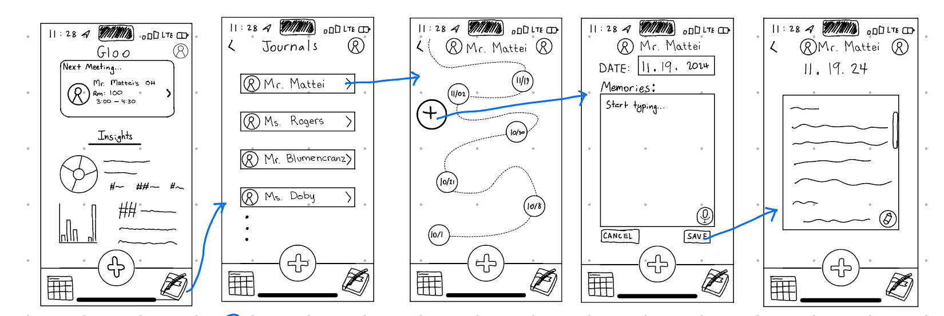
Major Change 2 - Record Notes
Before: Students navigate to their journal page, select a teacher, and creating a journal entry specific to that teacher.
User/Studio Feedback:
Connecting it to a teacher feels assignment-like.
Seeing a list of teachers after clicking the journal icon is unexpected.
The similarity between picking a teacher for OH and picking a teacher to journal about was confusing.

Slide 24
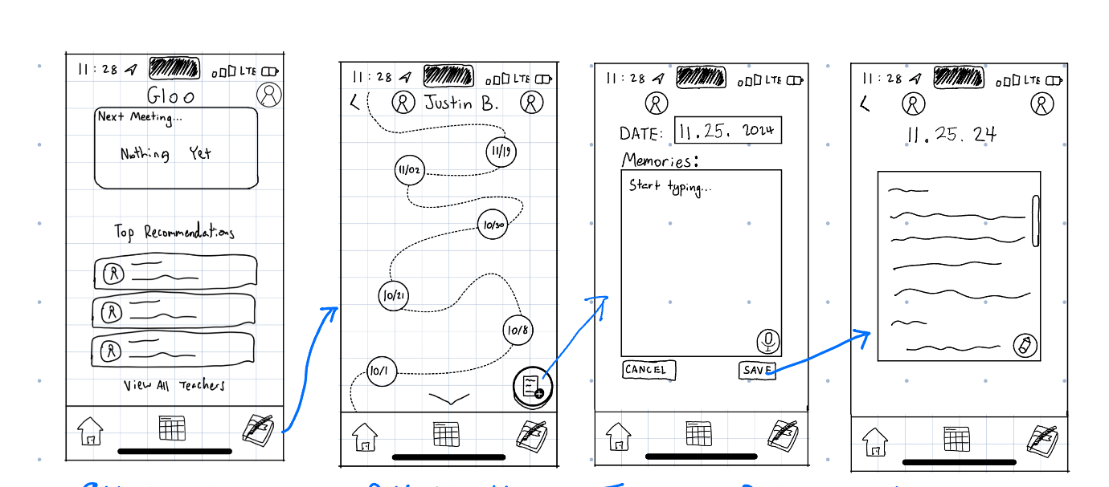
Major Change 2 - Record Notes
After: Students navigate to their journal page and create an entry linked to a specific date instead of a specific teacher. The “add entry” button is similar to commonly seen “new document” iconography.
Progress towards usability:
Navigable: We listened to user feedback about liking navigation icons.
Simple: Removing an unnecessary page cuts down overall task time.
Approachable: Users aren’t wasting time choosing between `+` buttons.

Slide 25
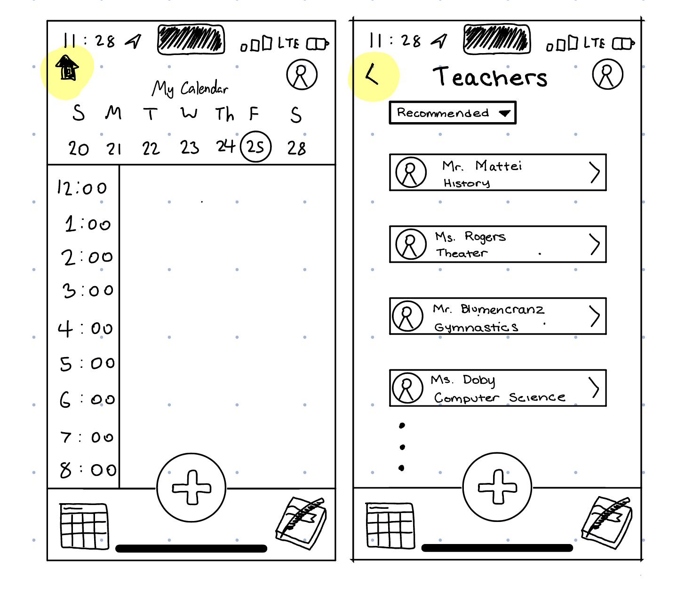
Major Change 3 - Improve Top Navigation Consistency
Before: Teachers and students had inconsistent top bar navigation depending on how far they were from the home page.
User/Studio Feedback:
Replacing the back button with a home button when a user was more than one click from the homepage was unintuitive.
When users looked for a back button and couldn’t find it, decision making time increased.

Slide 26
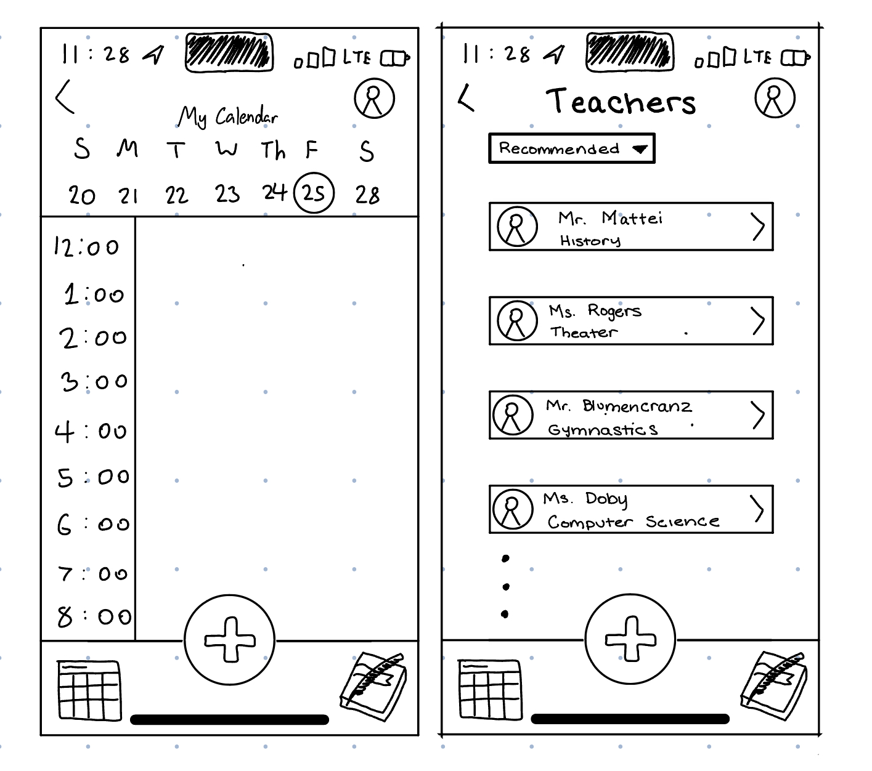
Major Change 3 - Improve Top Navigation Consistency
After: Users can navigate back from any page except a submission screen.
Progress towards usability:
Navigable: Users can rely on the footer for all navigation except backing up a page.
Simple: The top navigation doesn’t switch between back and home.
Approachable: A consistent layout builds user comfort and confidence.

Slide 27
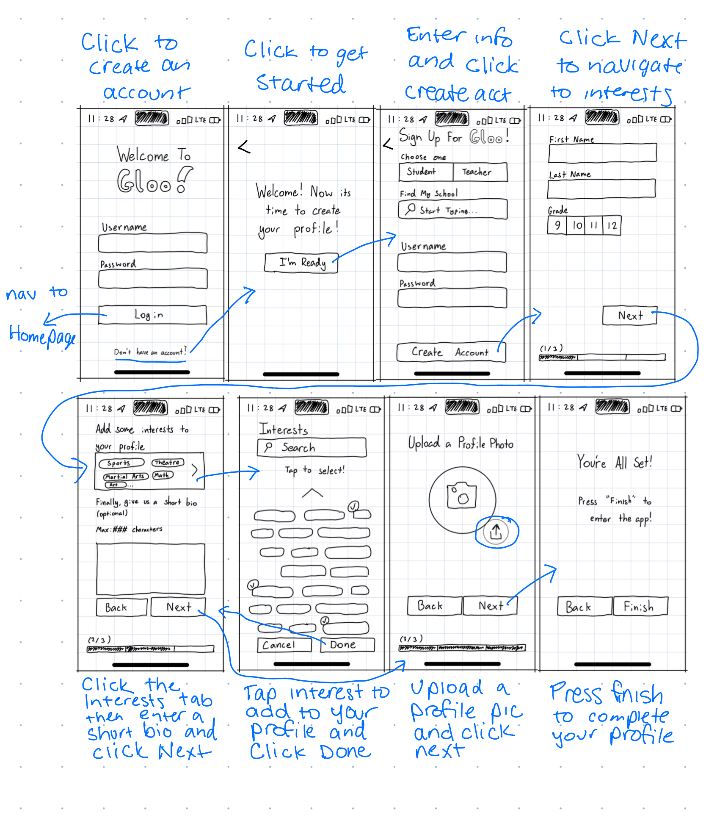
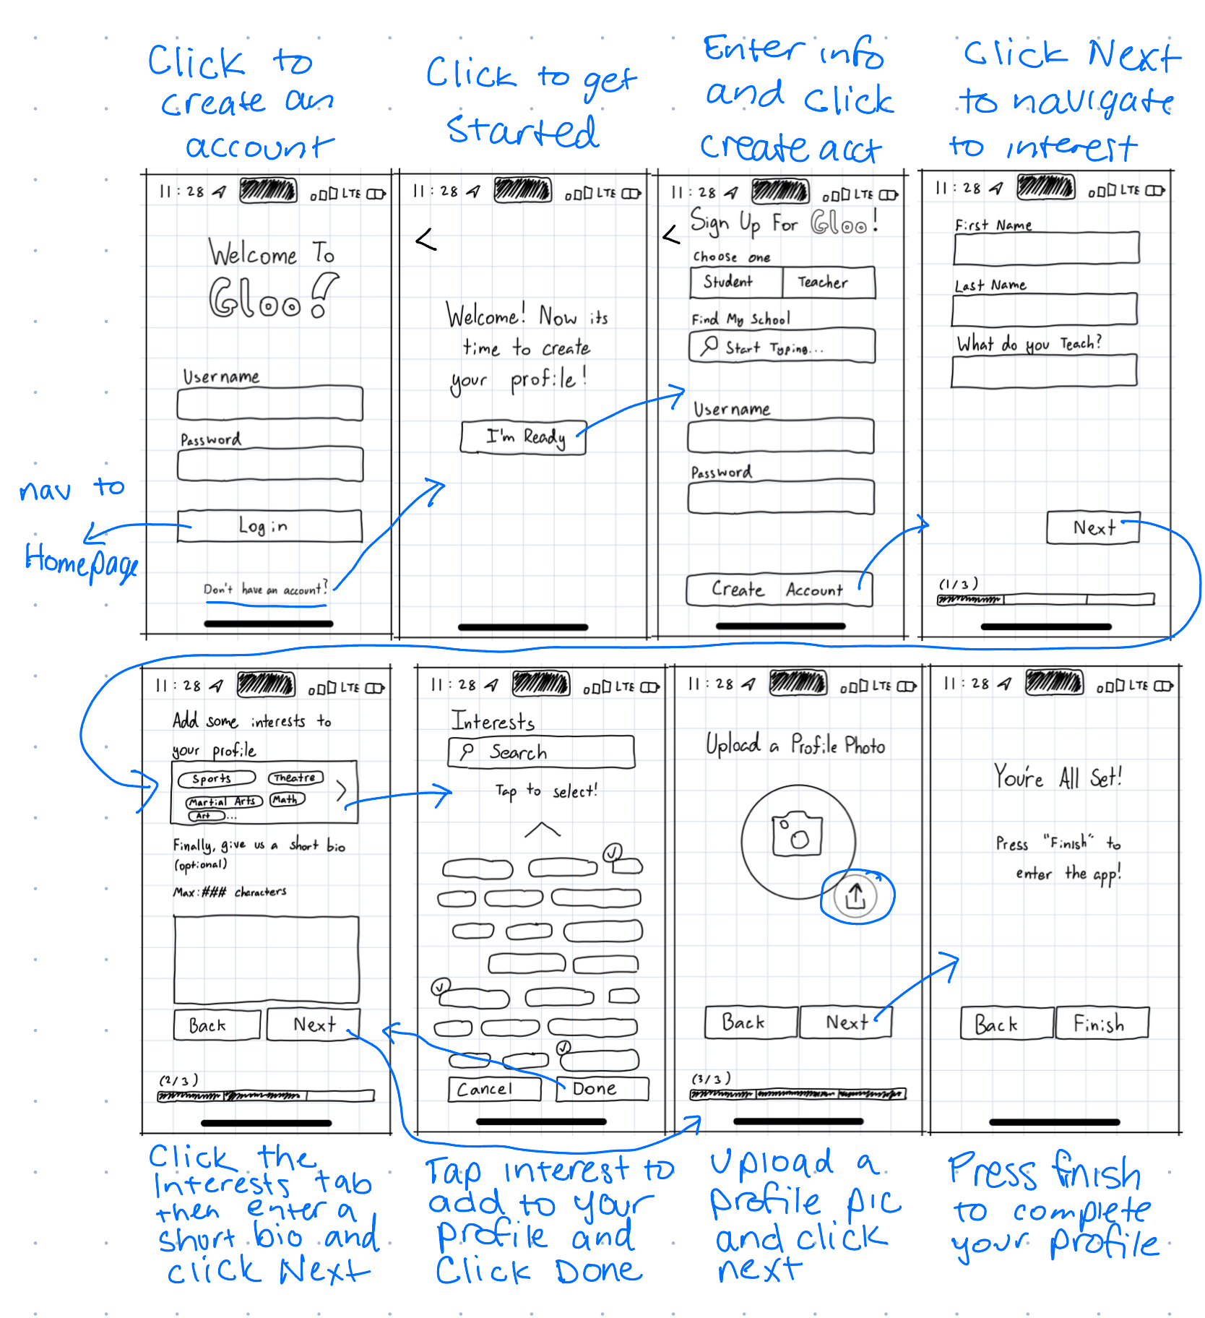
New Task - Make a Profile
Student Profile
Teacher Profile

Slide 28
6
Med-Fi Task Flow

Slide 29
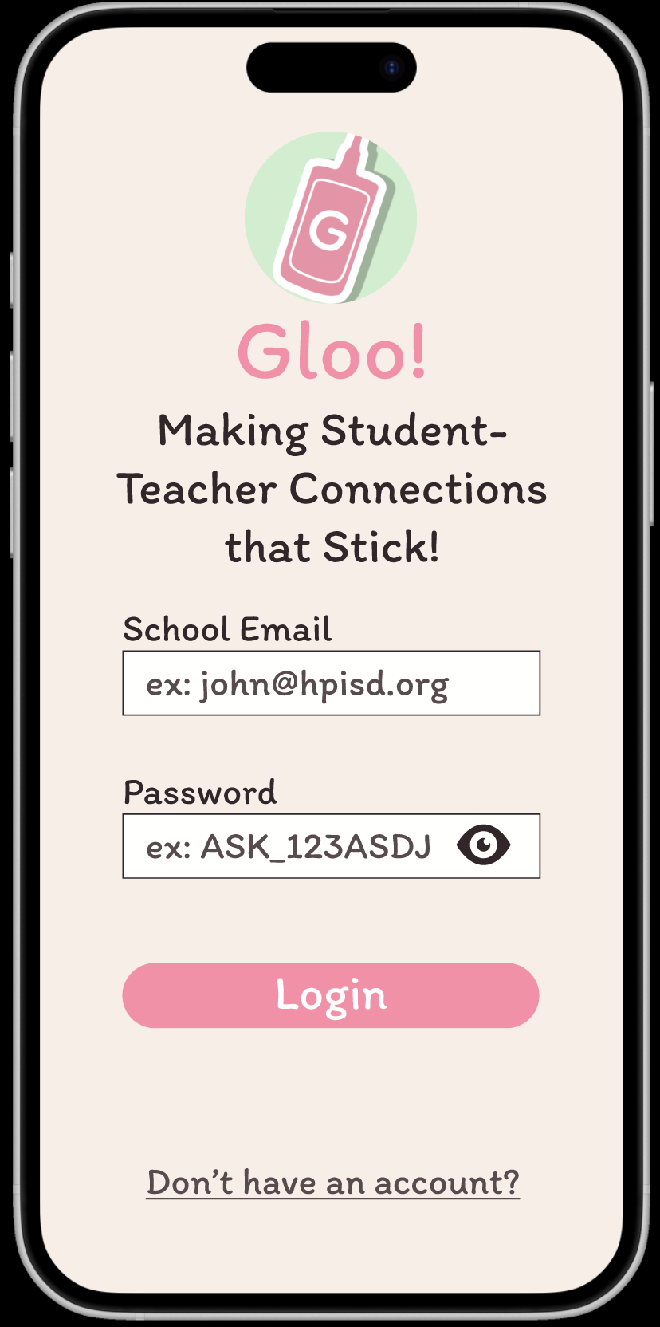
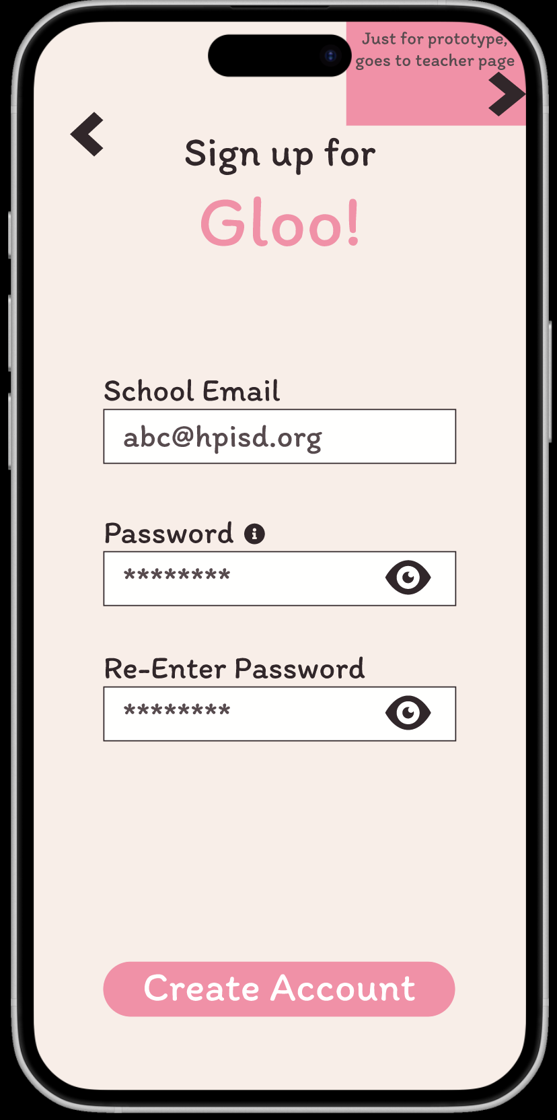
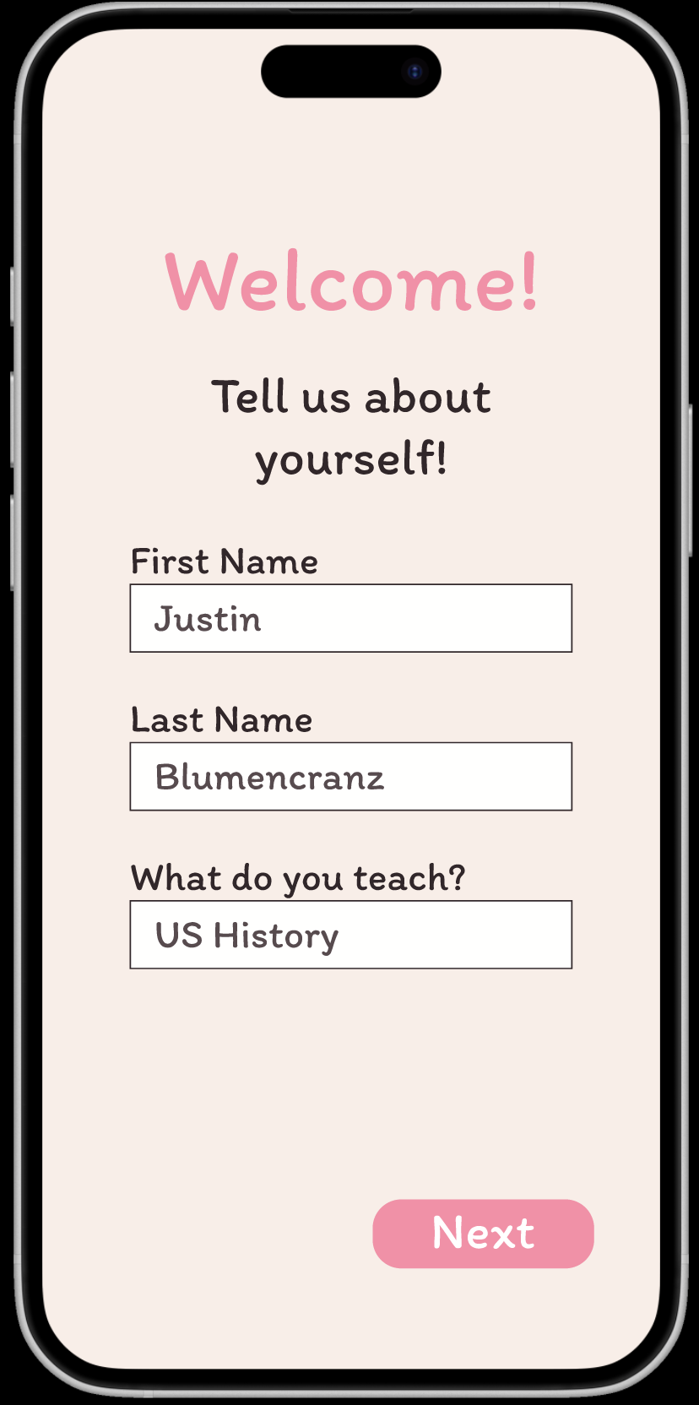
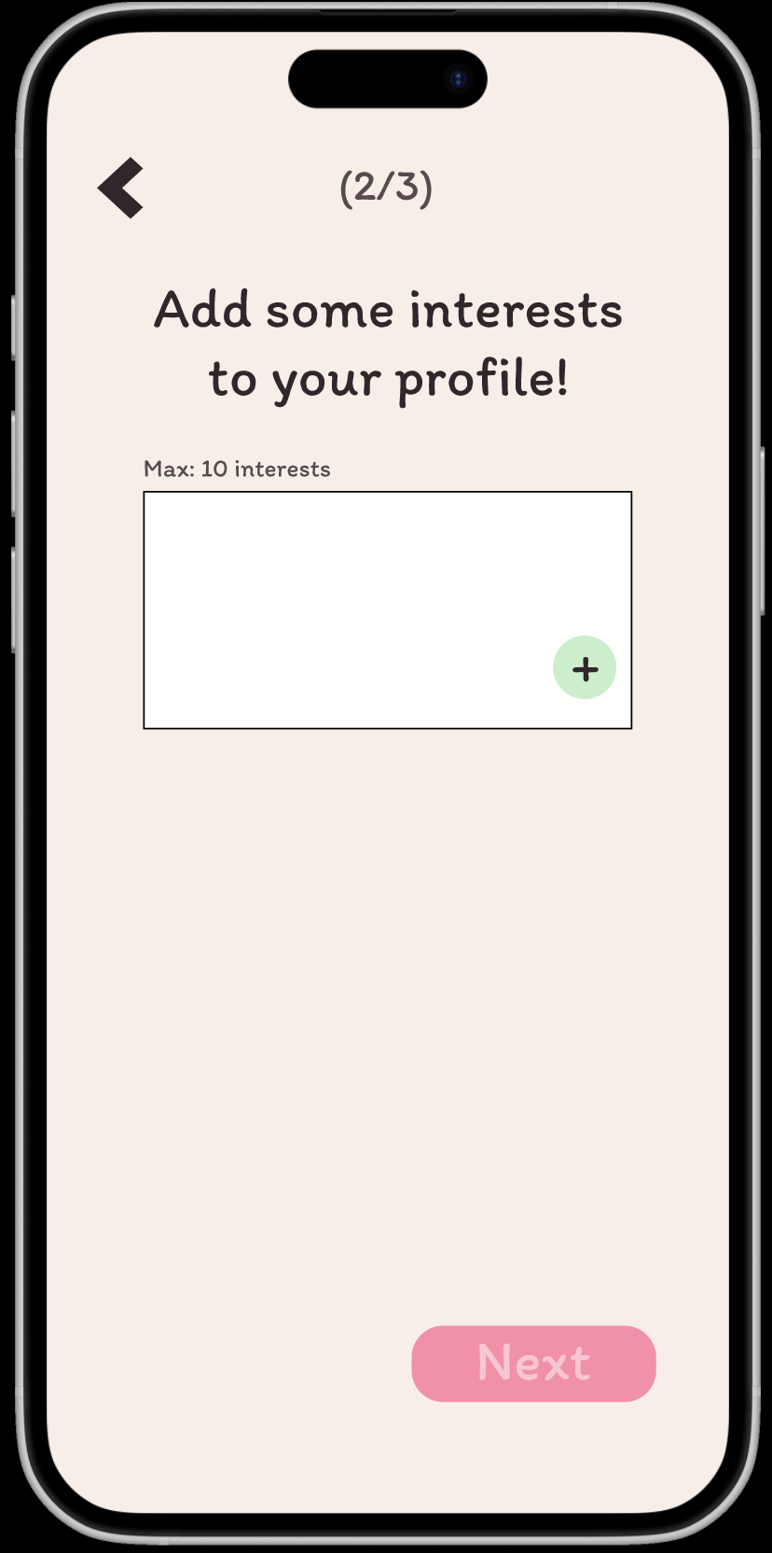
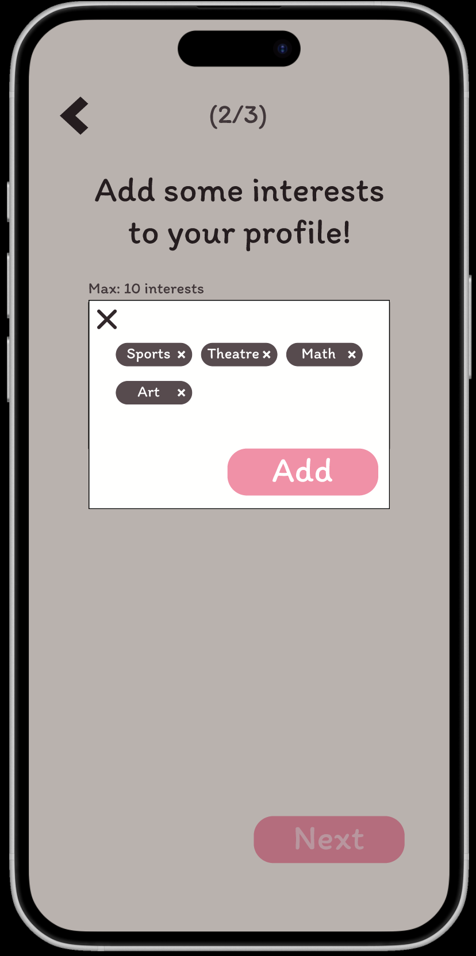
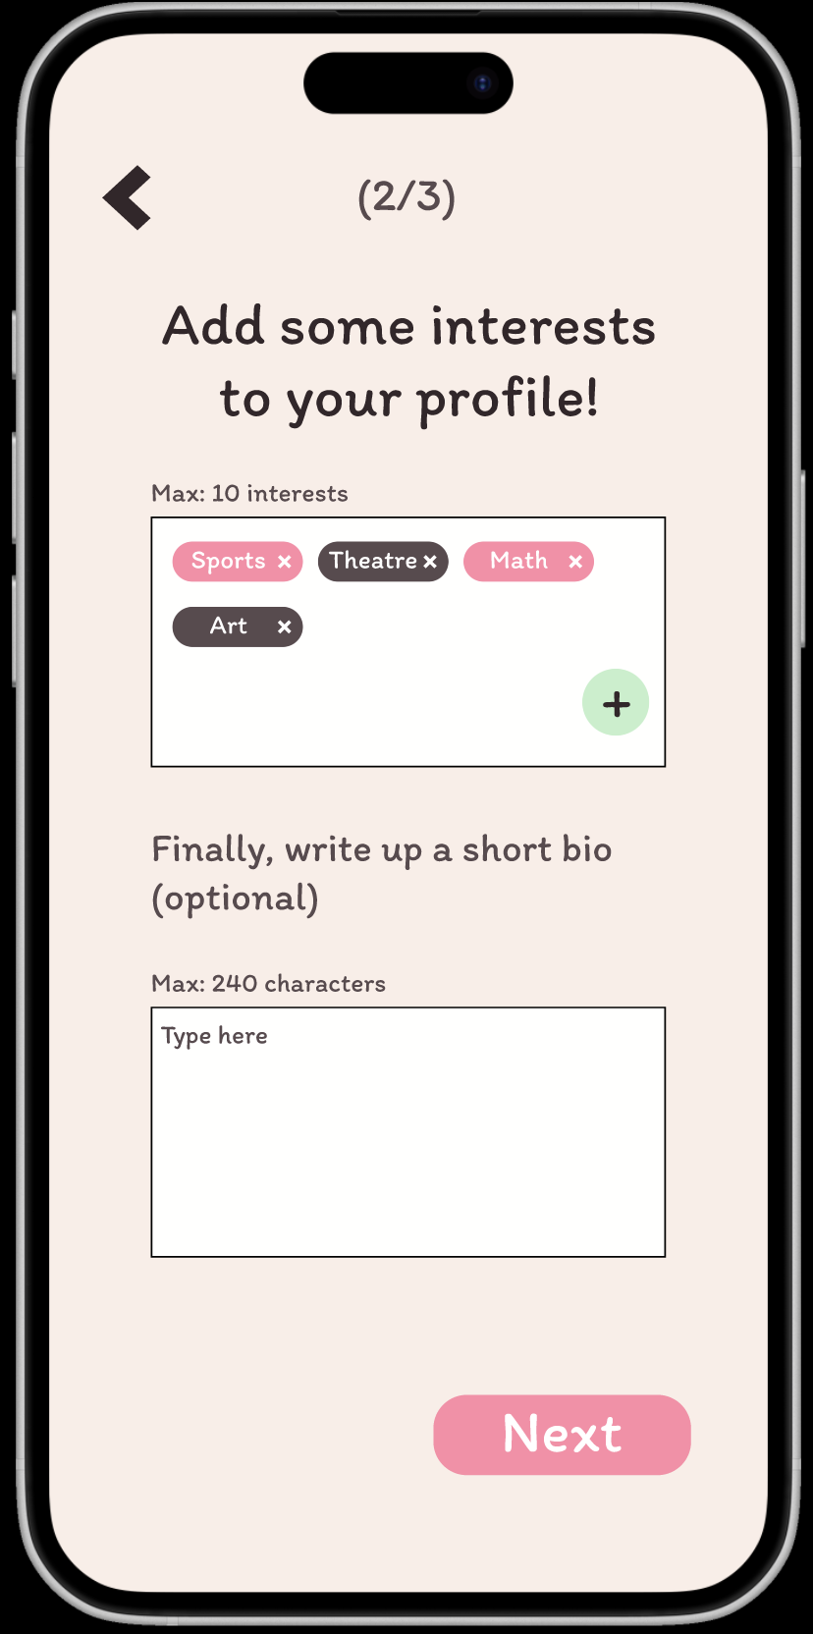
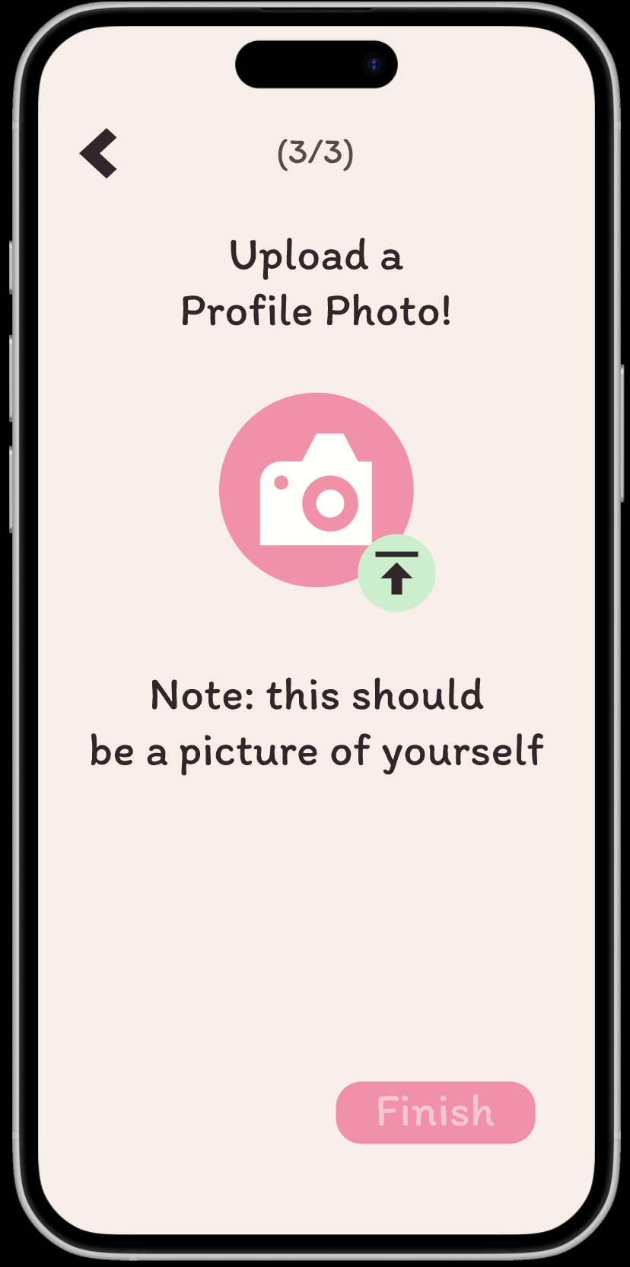
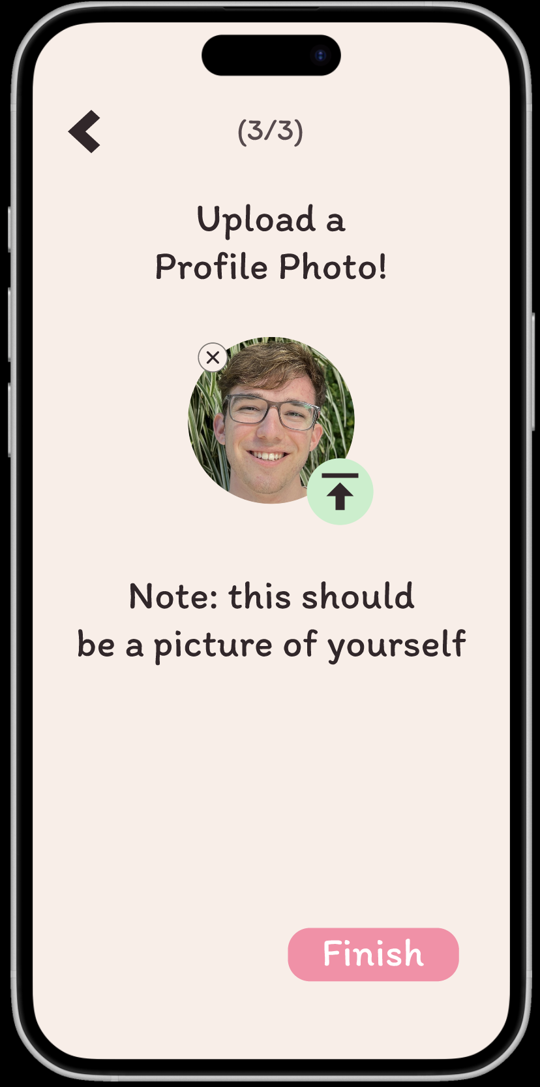
Teacher Profile Creation
Landing Page
Sign Up Page
Page 1 of Profile Creation
Interests Page
Interest Click-to-Select
Bio/About Me Page
Profile Picture Prompt Page
Profile Submission Page
Added landing page description + guidance on expected format of input fields. Made account creation link obvious.
Added call to action text to the header. Added text field guidance for email and made password optionally viewable for accessibility. An info button tells you password requirements.
Added short task description to orient user on the page. Text guidance is in grey to minimize errors and lead users through the task flow efficiently.
A short description tells the user what to do, and a green icon indicates expected action. Input limits are made clear.
This click-to-add input style is accessible and expedites the expected duration of the task flow.
Interests show up with color variation to aid in differentiation.
Adding a short bio is optional, quickly onboarding users.
Clear instructions and limitations. Action item button highlighted in green to coach users through onboarding.
Finish greyed out.
Now that the profile is complete, users can click “Finish” to access the Gloo application.

Slide 30
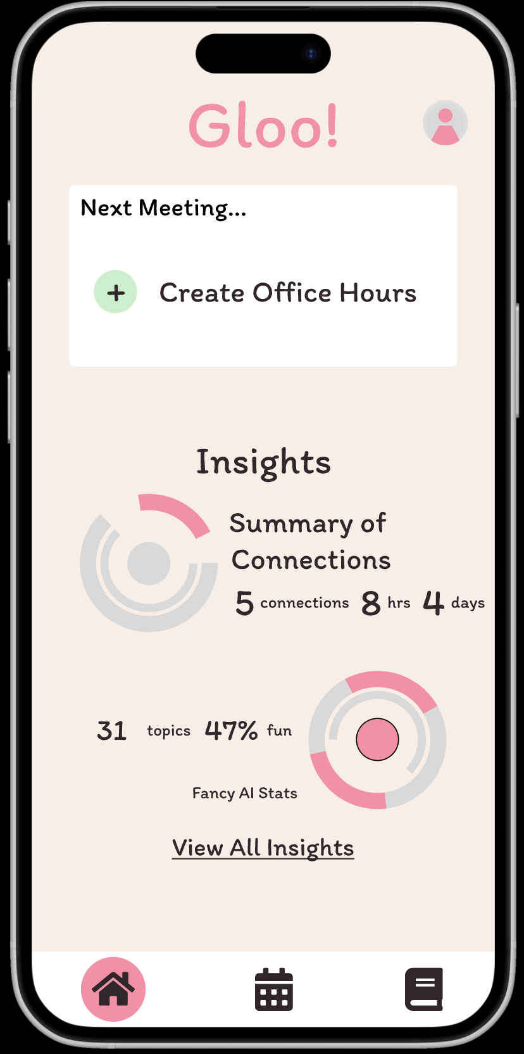
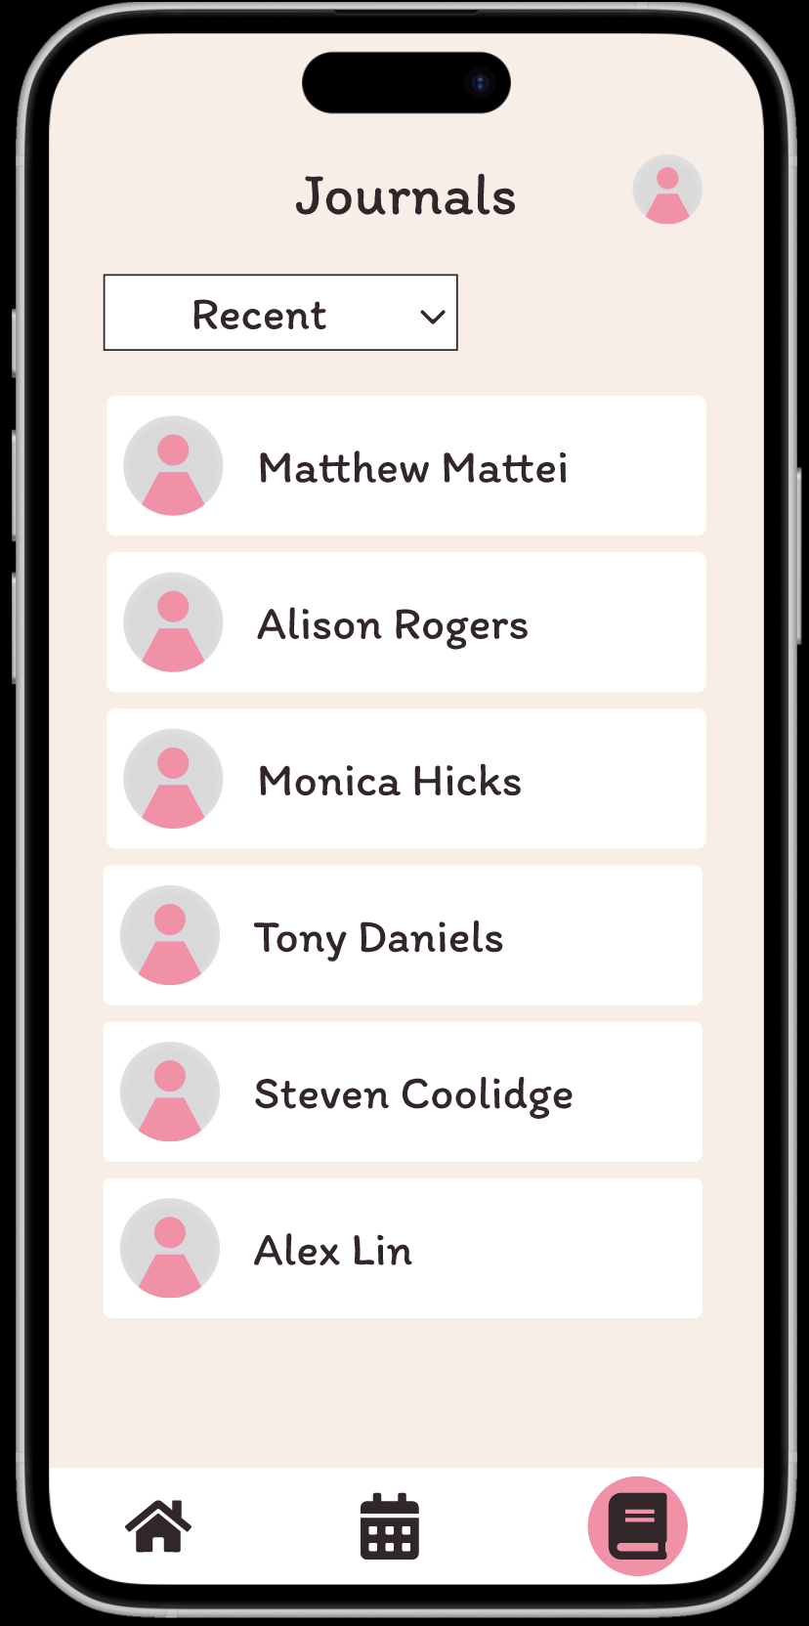
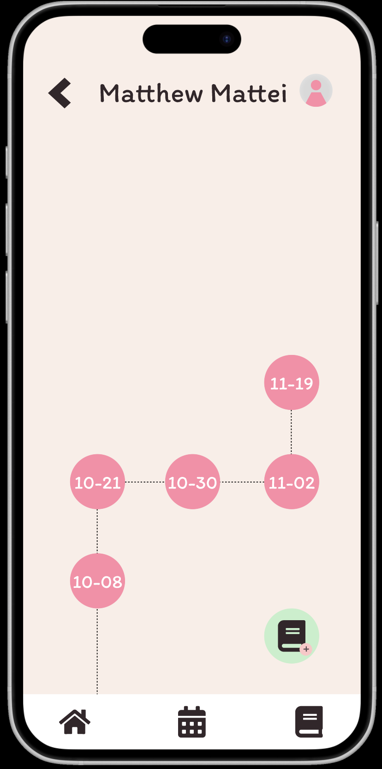
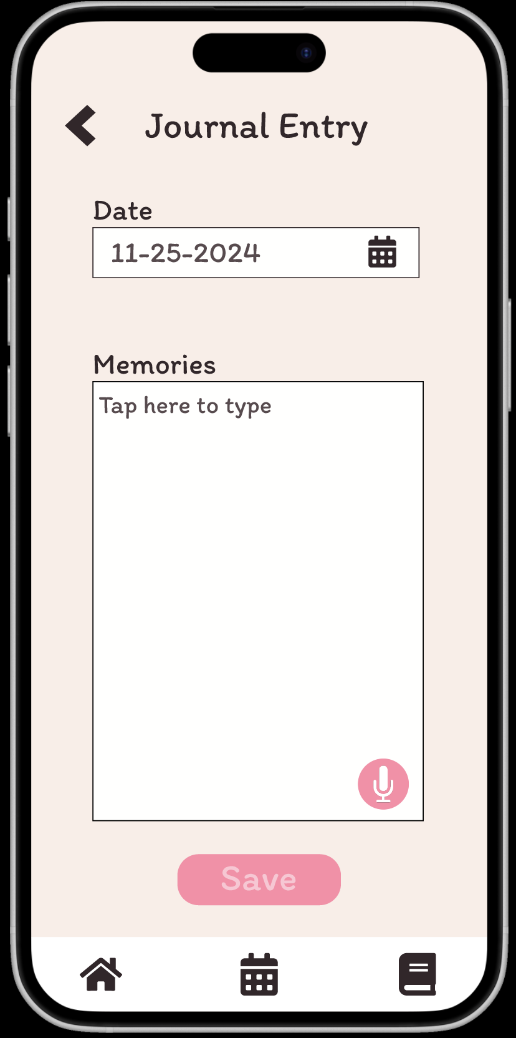
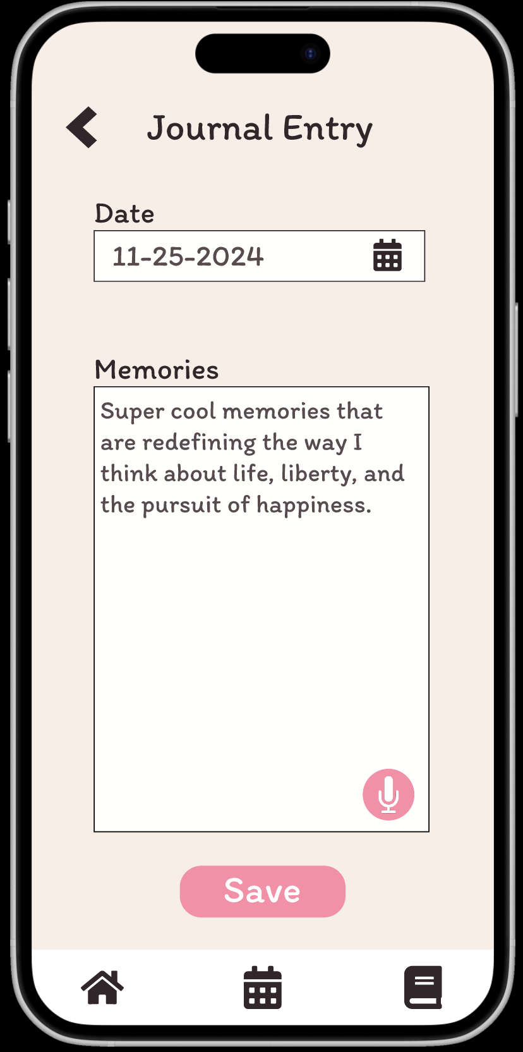
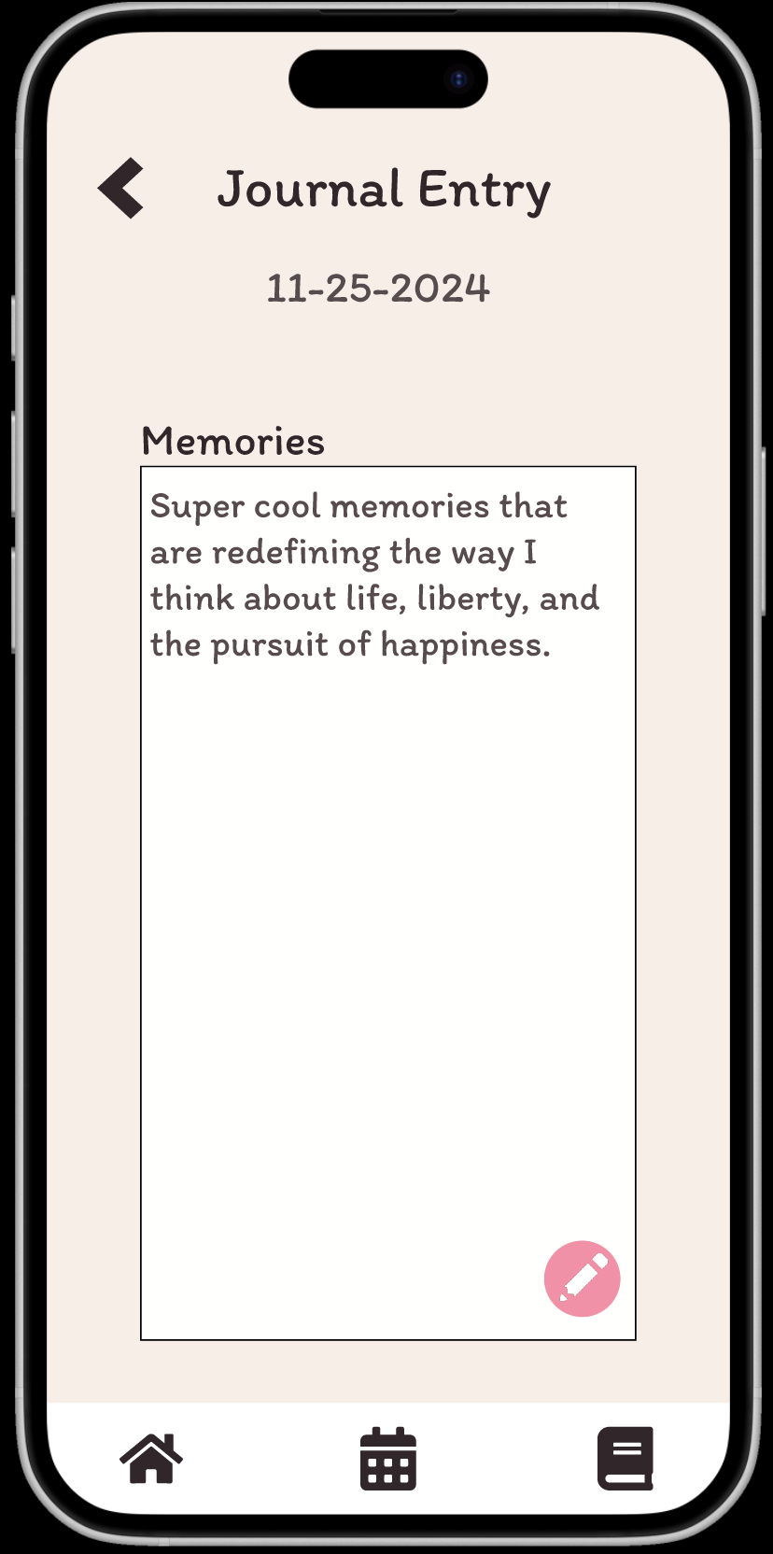
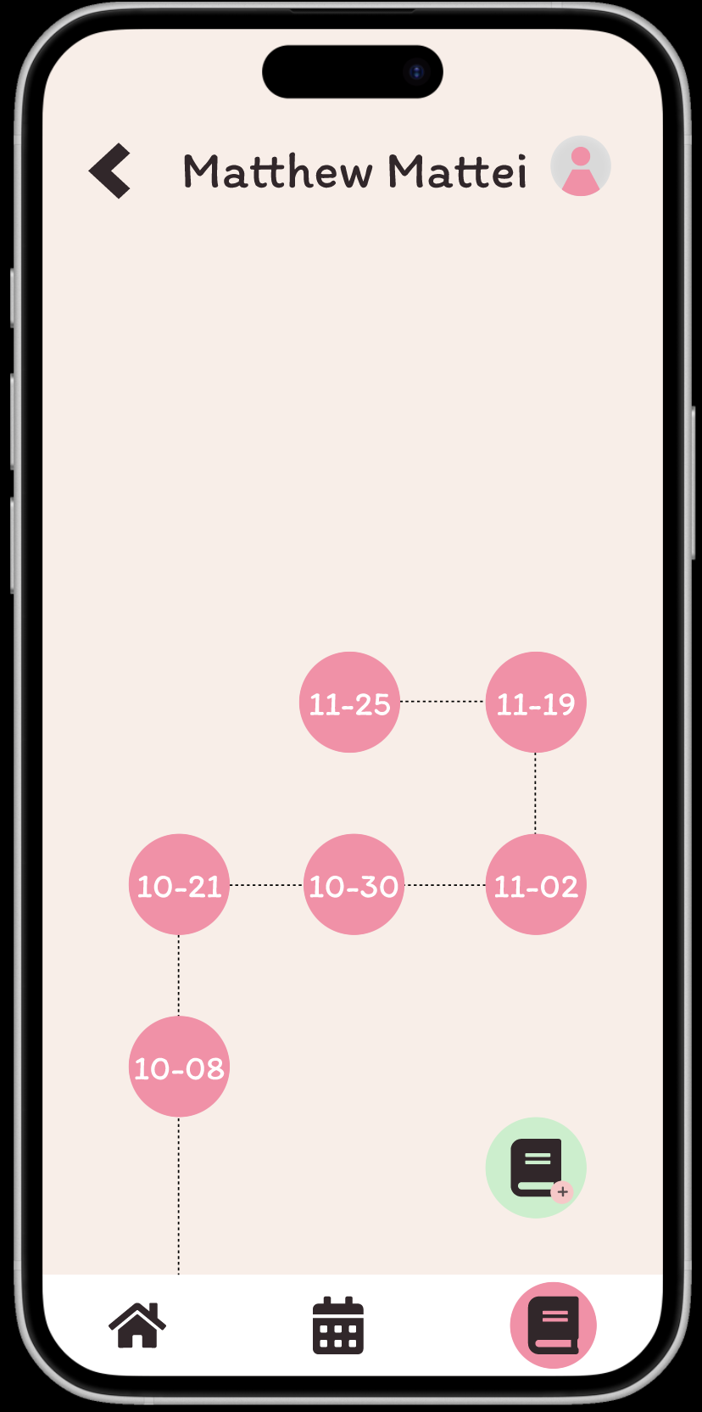
Teacher Record Notes
Home Page
Journal Landing Page
Journal Journey Page
Journal Entry
Entry Submission
Entry Confirmation
Journey Page with New Entry
Color added to nav bar to orient users. Simple book icon leads user to the journaling landing page.
The student journal page is default ordered by recent activity. There is no back button available to reduce redundancy with home button.
Action icon is highlighted in green, A small plus button indicates adding a new entry.
Entries ordered chronologically.
Grey text guides the user. A pink microphone icon provides an accessible option to enter notes via voice-to-text.
The save button becomes clickable once text is entered to prevent users cluttering the journey page with empty entries.
Users can click to edit their entry or click to navigate to the journey page by using the back button.
The new journal entry appears on the journey page in correct chronological order.

Slide 31
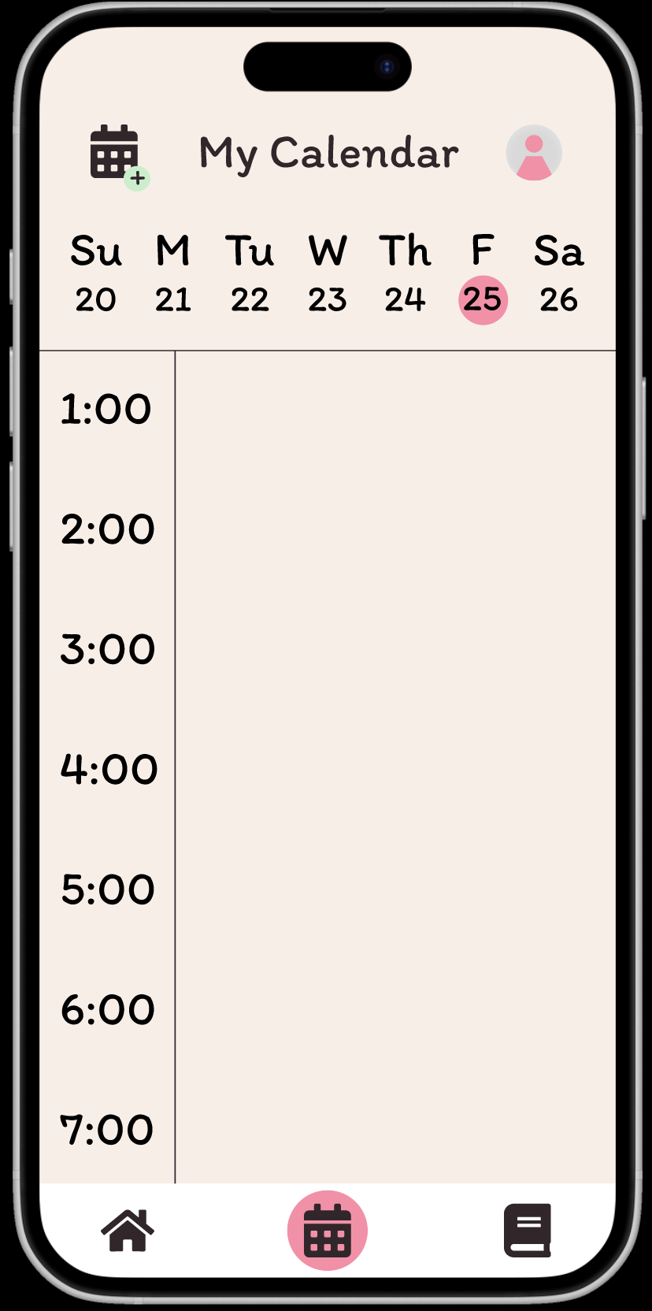
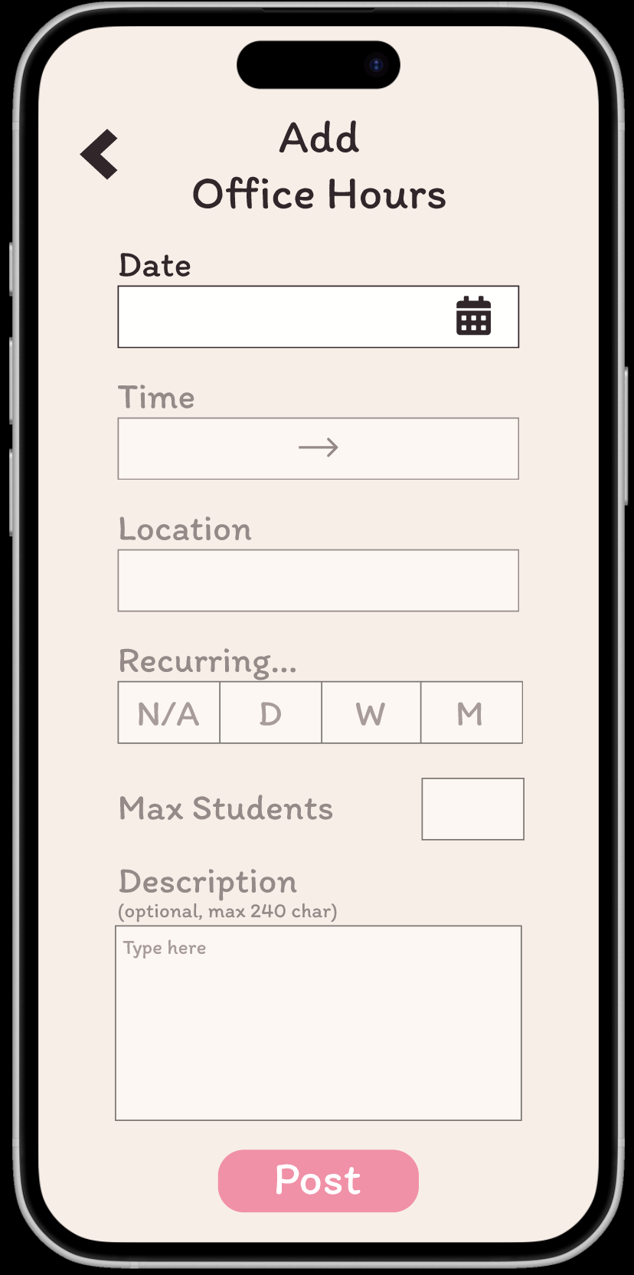
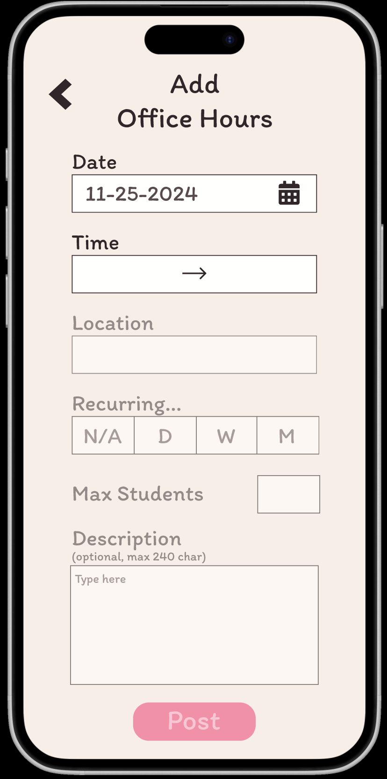
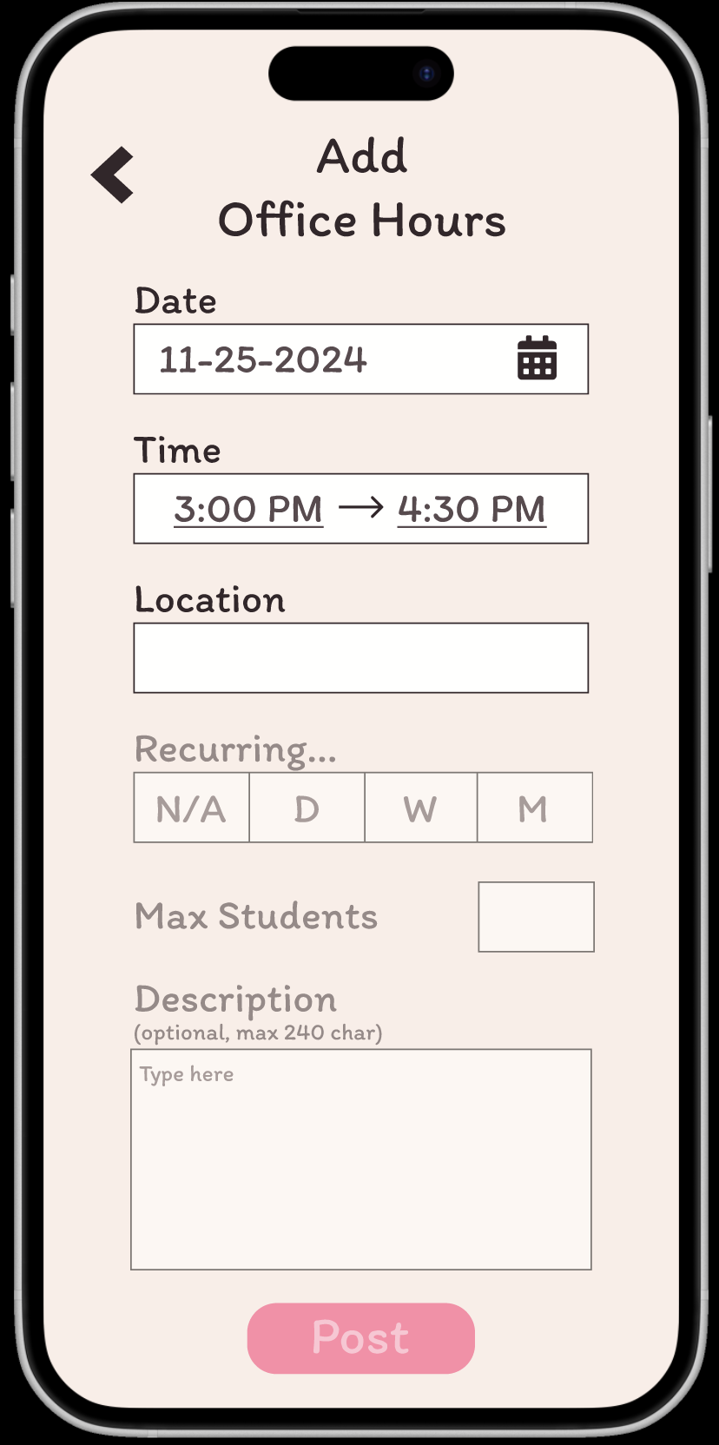
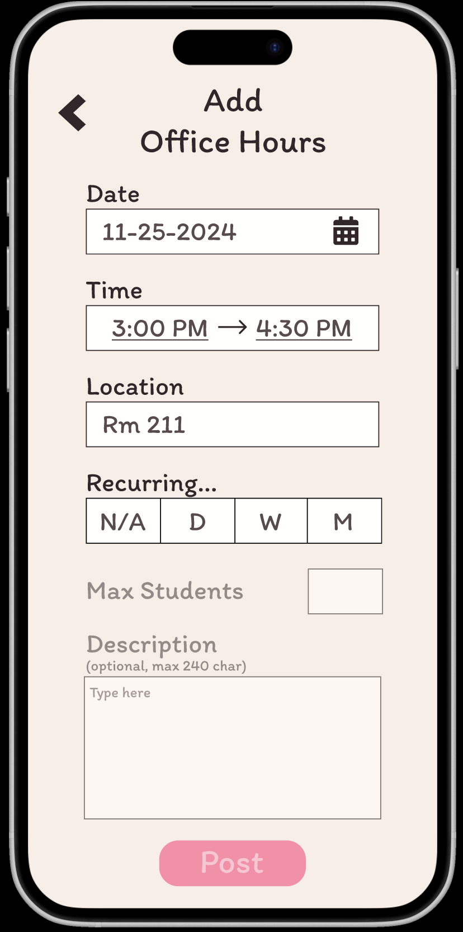
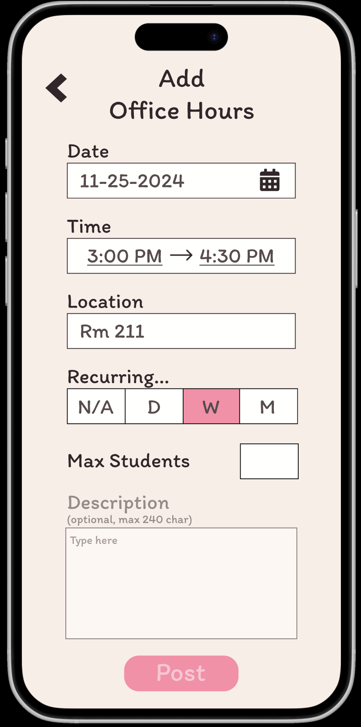
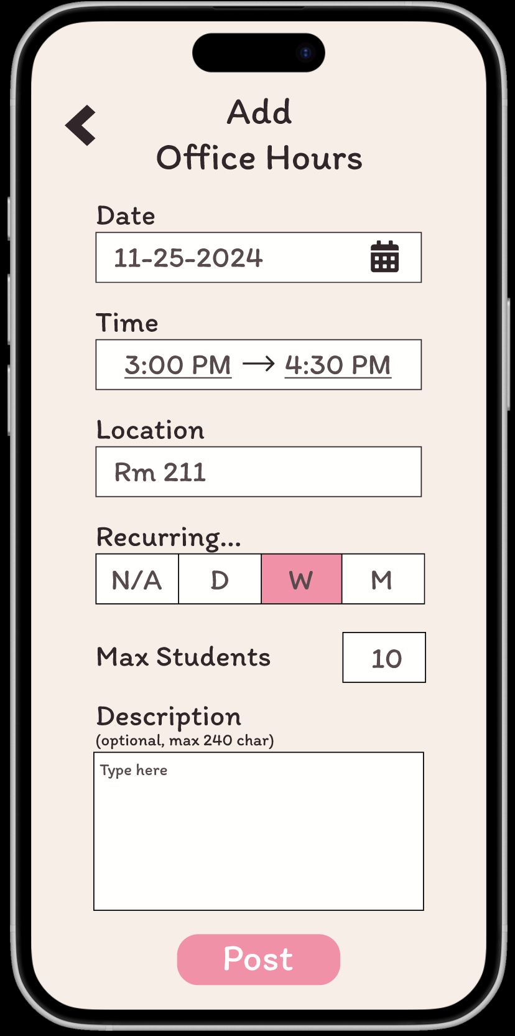
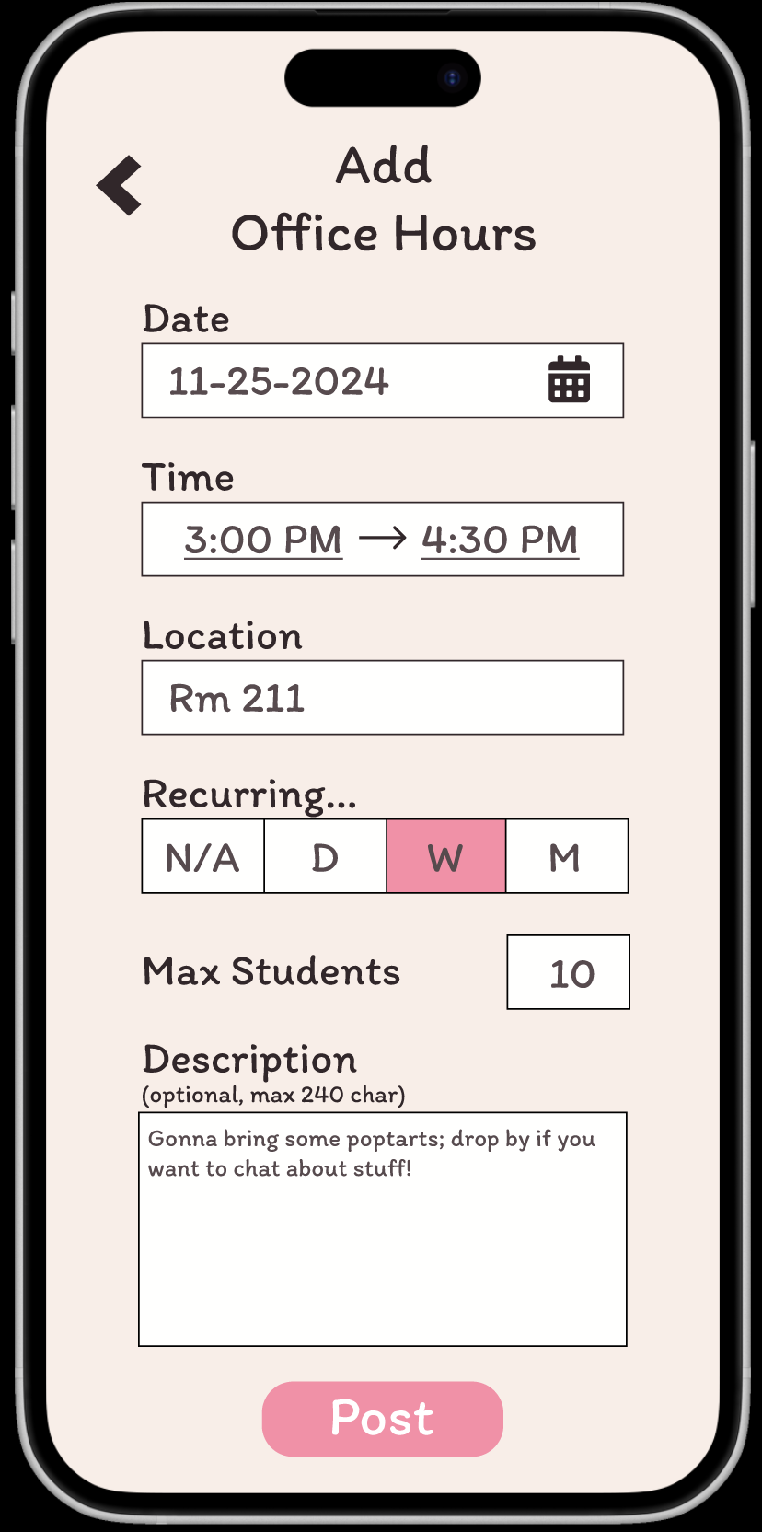
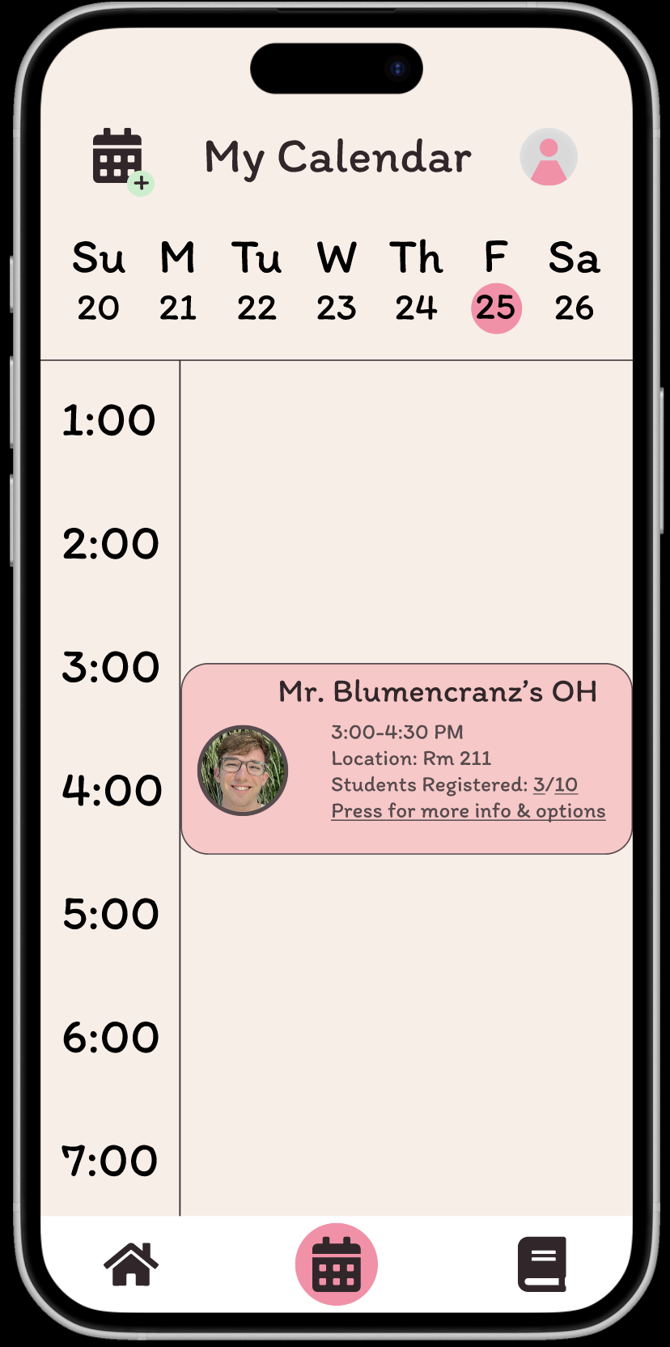
Calendar Page
Teacher Create + Share OH
Add Date
Add Time
Add Location
Set
Recurrence
Set Capacity
Add Description
Submission Screen
Confirmation on Calendar
User clicks calendar icon to pick the OH date.
Click to input start and end time.
Text entry for room location.
Tap-to-select recurrence relation.
Set OH capacity through text entry.
Add an optional short Office Hours description or post instantly
The only option at this stage is to post the office hours or return to the Calendar View.
Teachers will see their Office Hours populated to their calendar instantly upon submission.
Home Page

Slide 32
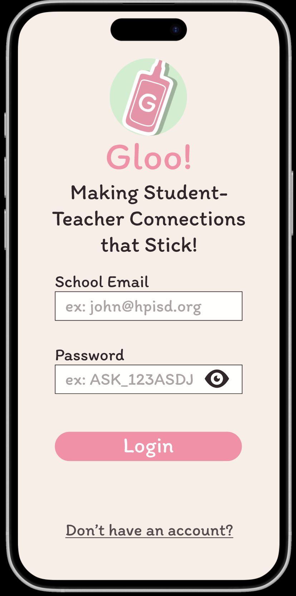
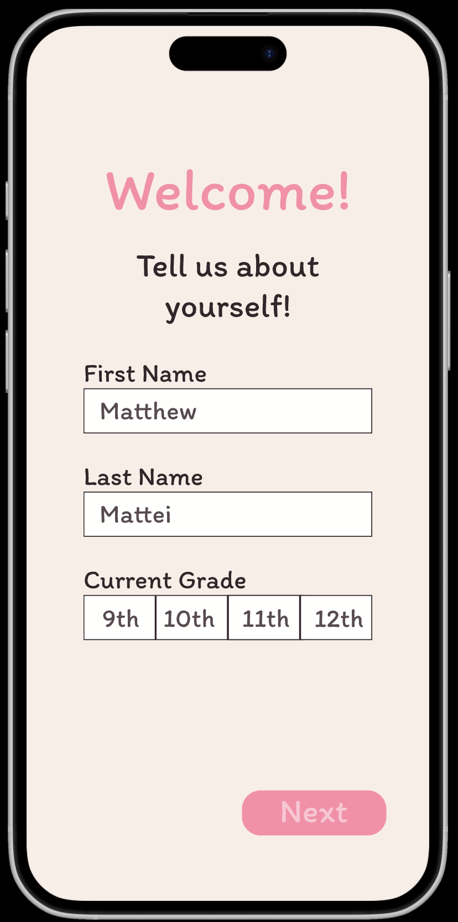
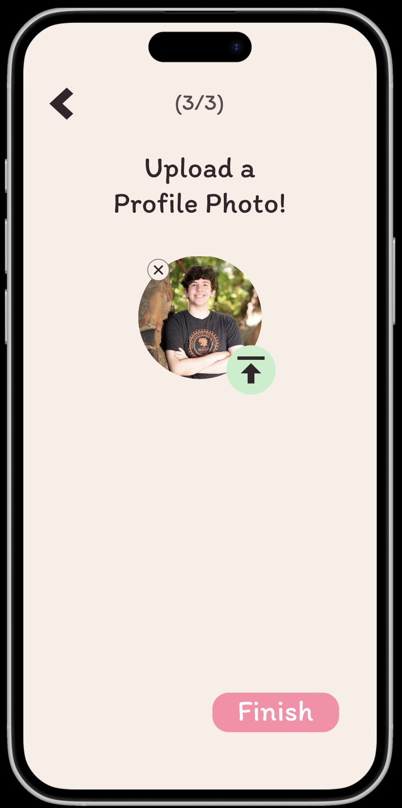
Student Profile Creation
Landing Page
Sign Up Page
Page 1 of Profile Creation
Interests Page
Interest Click-to-Select
Bio/About Me Page
Profile Picture Prompt Page
Profile Submission Page
Same as Teacher profile creation except for Subject Selection is replaced with Current Grade selection

Slide 33
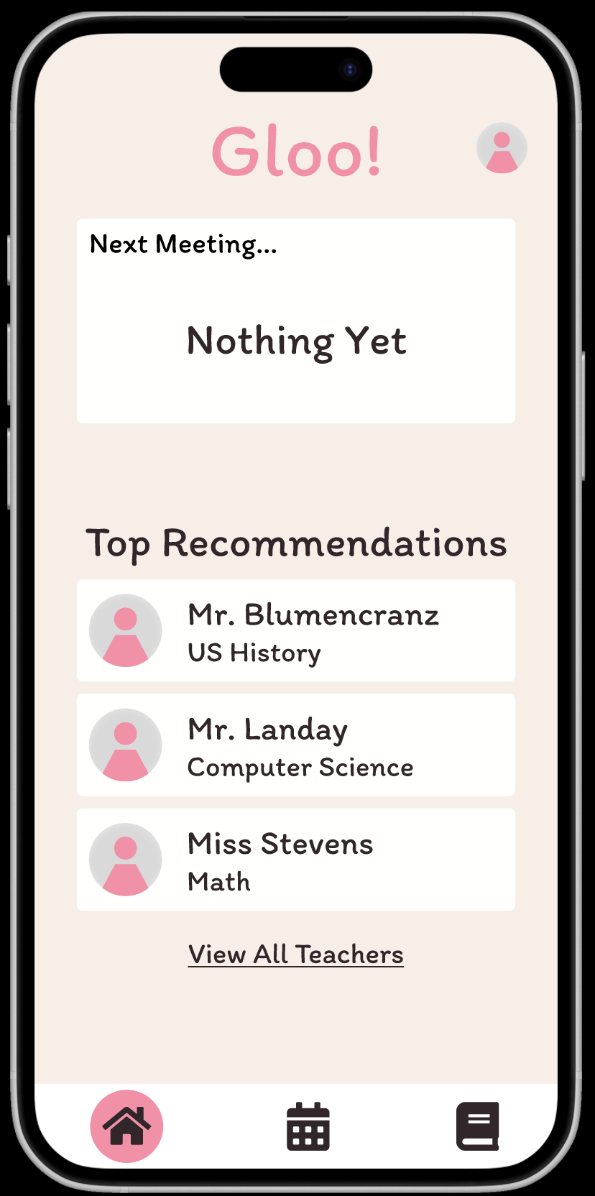
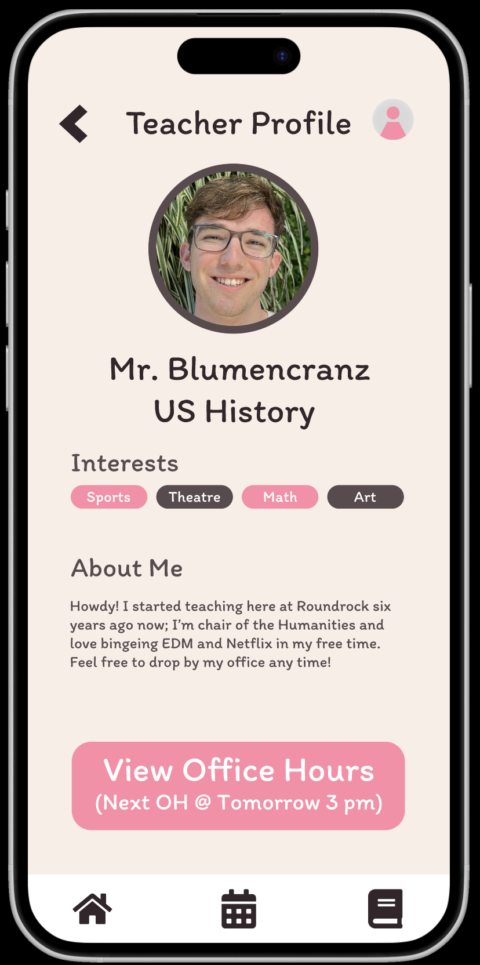
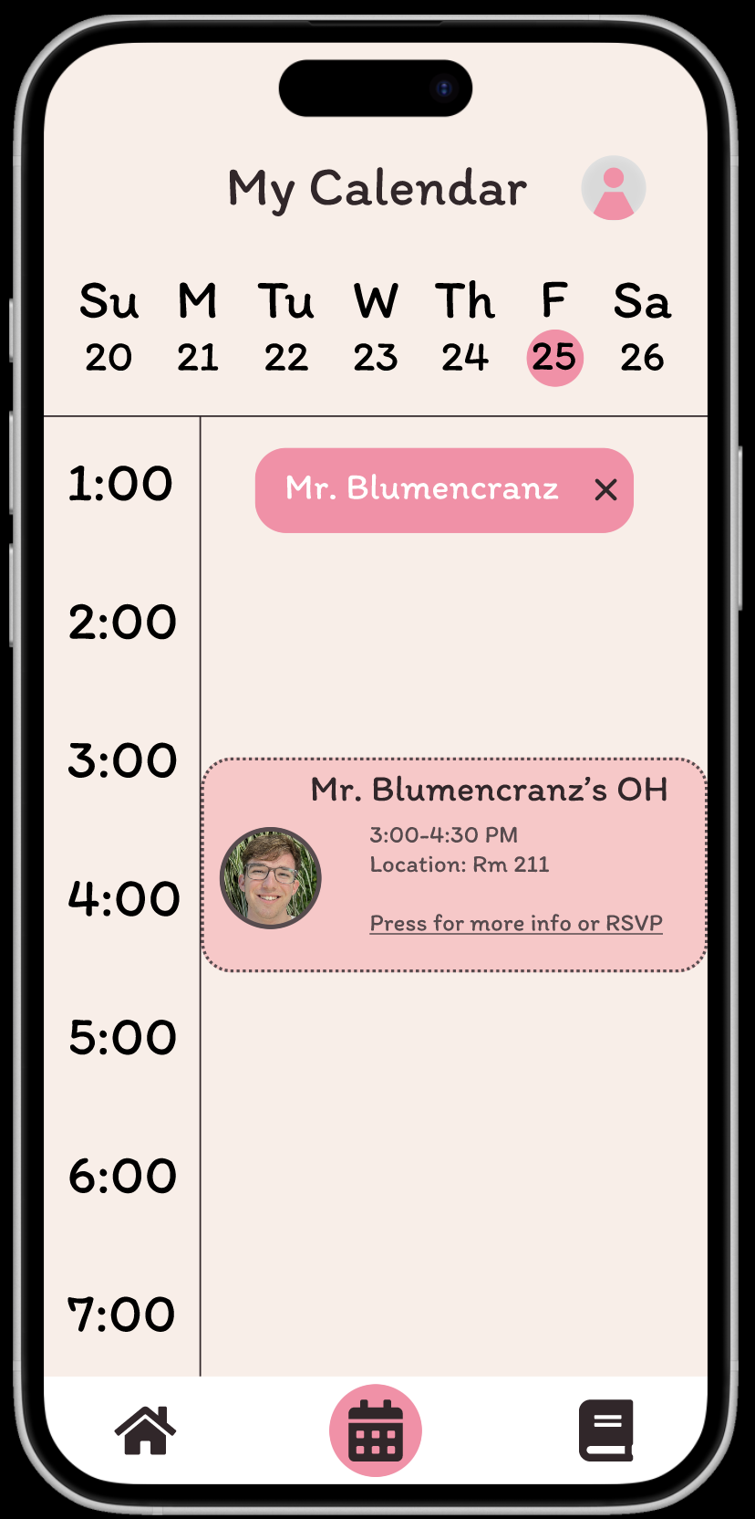
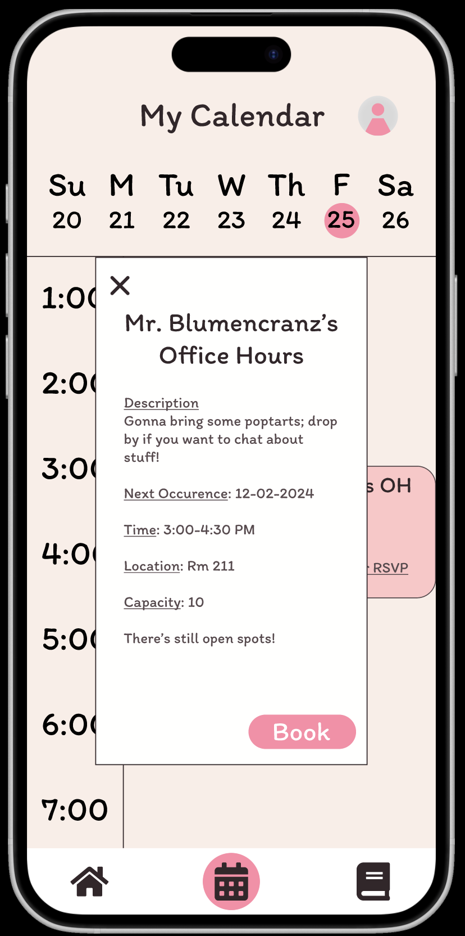
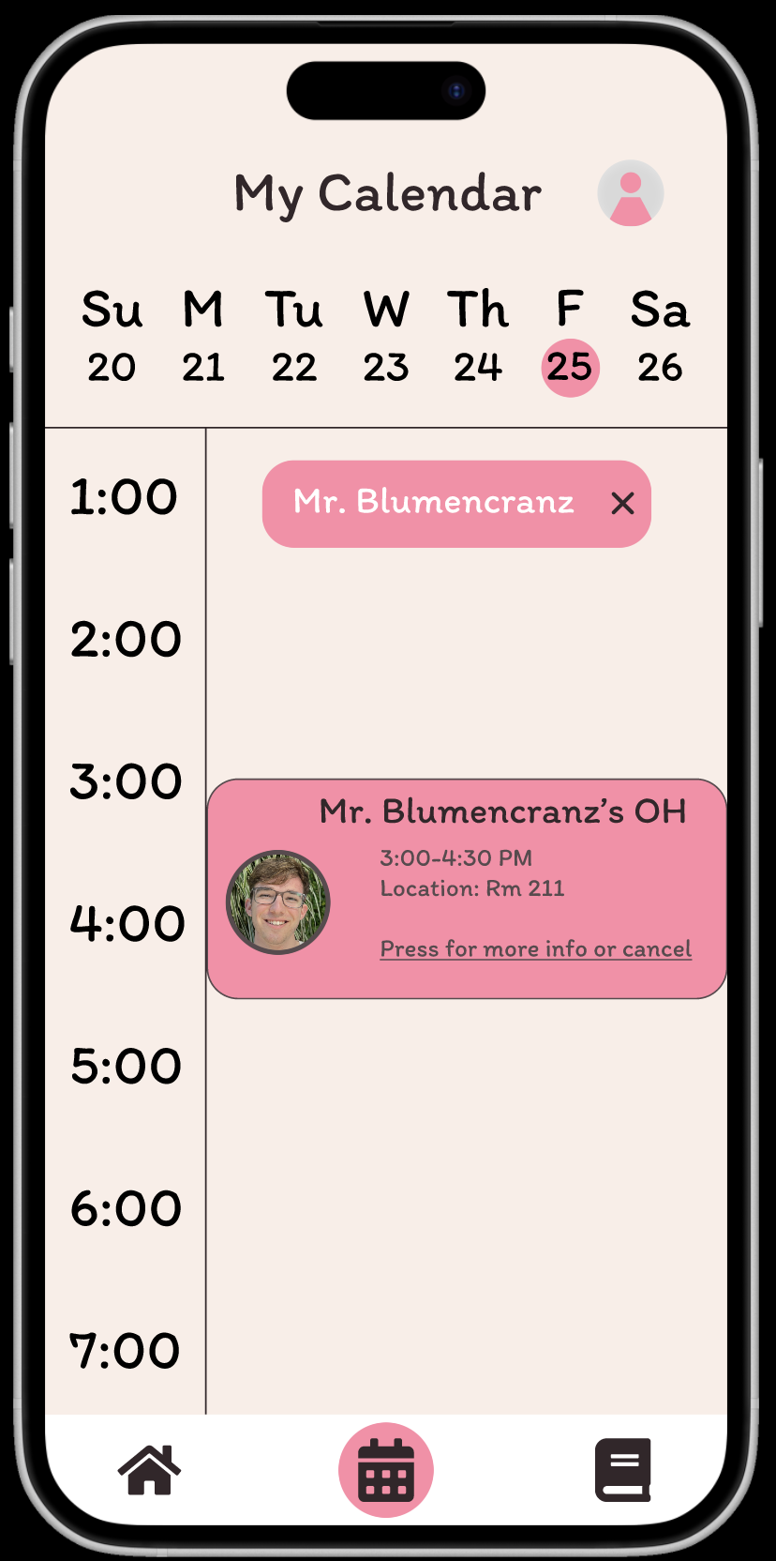
Student Book OH
Home Page
Teacher Profile
Calendar View
OH Card View
RSVP Confirmation
Changed “View All Teachers” to make obviously clickable.
Select widget to view Teacher Profile.
First look is Teacher picture + name. Second look is View Office Hours.
Tile is light pink with a dashed border to show OH are available but not yet booked.
Pop-out card view shows all relevant information. Student can book or exit.
Tile now shows up in dark pink with a solid border.

Slide 34
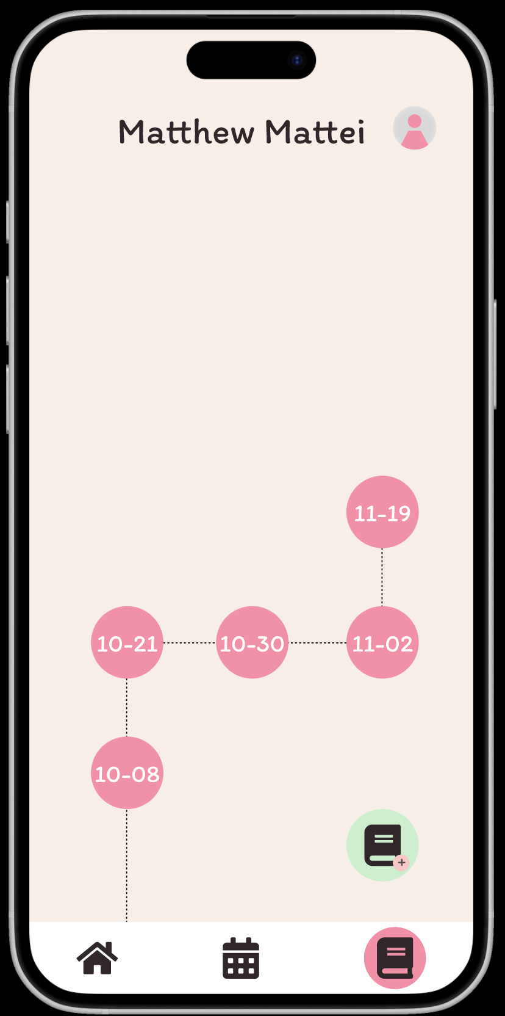
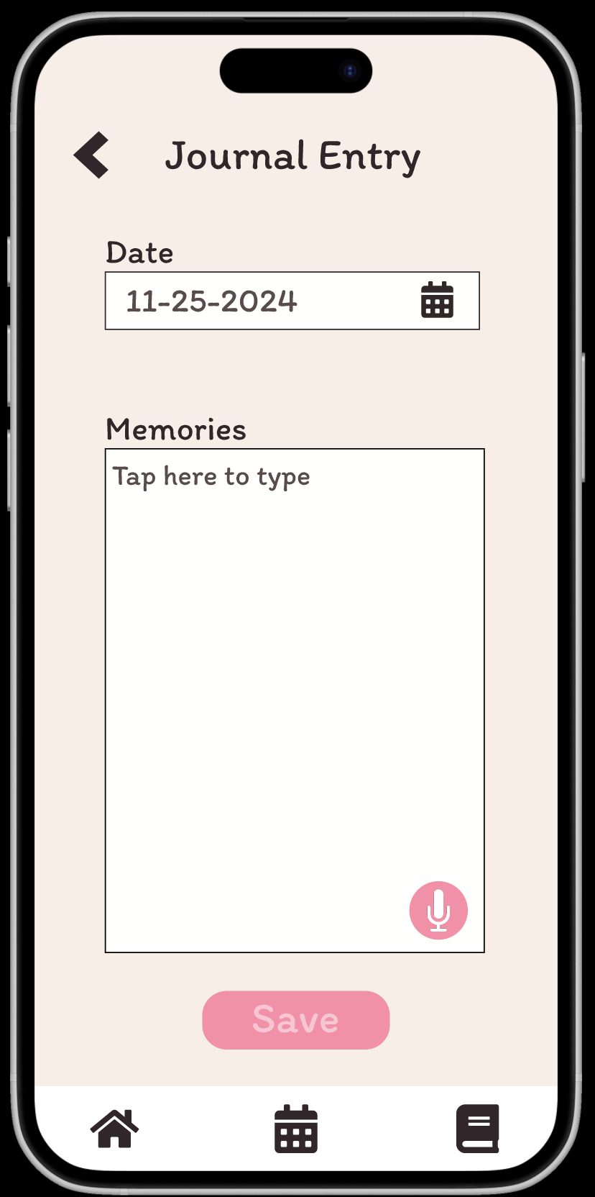
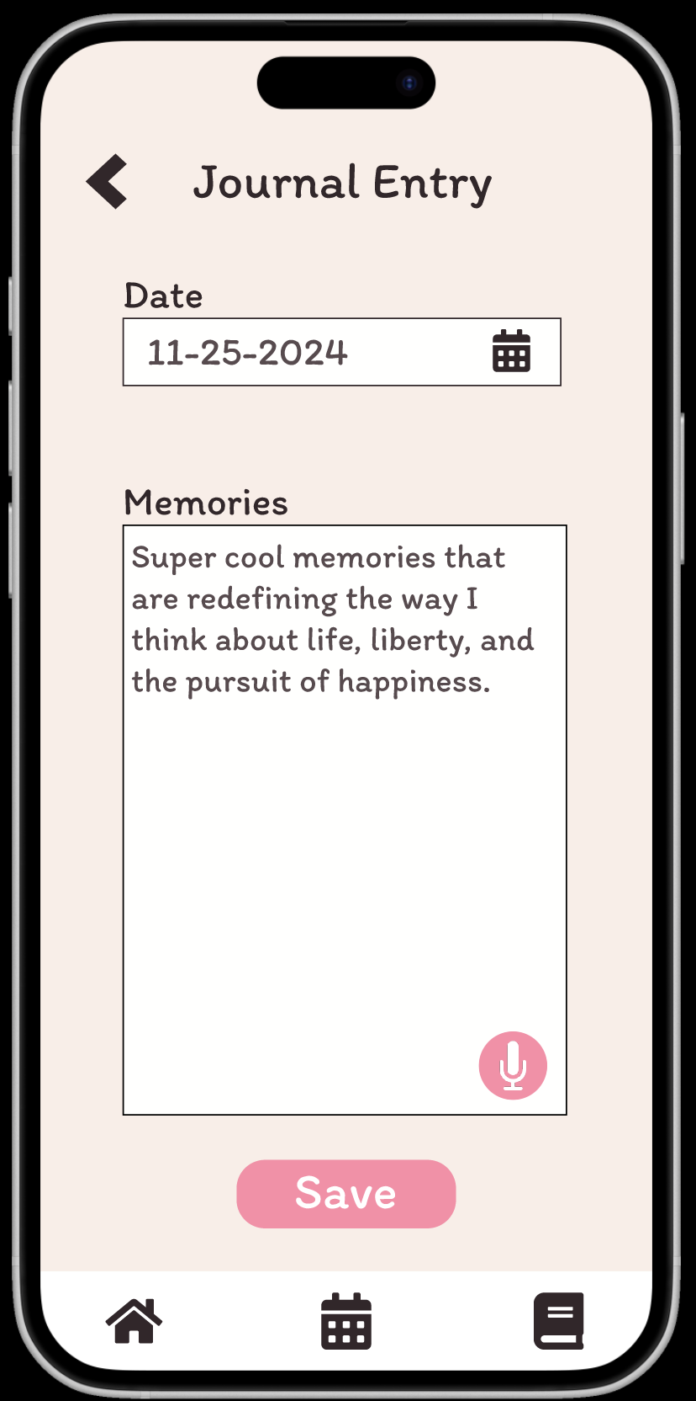

Student Record Notes
Home Page
Journal View
Journal Entry Page
Entry Submission
Entry Confirmation
Same as Teacher View for record notes, but the View Teachers page has been removed

Slide 35
7
Prototype
Implementation

Slide 36
Prototype Implementation
Details from the README
Tools | Figma Pros - Low barrier to entry; minimalist and aesthetic (H8); fast time to create Cons - Less interactive than a true app; new skillset to learn prior to starting; UI abstracts some control over designing the app (such as navigation)
Limitations | Profile creation is not persistent All “users” you find while navigating the app are not real users New data, such as for the profile and calendar, cannot be dynamically applied to their respective pages Text fields are not interactive These limitations were tolerated for the med-fi prototype due to the toolset available to us in Figma, and users still experience a decent representation of the app appropriate for medium-fidelity without these features.
Hard-Coded / Wizard of Oz Details | Wizard of Oz Top Recommendations Our med-fi prototype does not have real users, so the “Top Recommendations” on the Student Home Pages contain static user data and are not selected using any sort of algorithm at this stage. Hard Coded Items Teacher Profiles and Office Hours All teacher data and available office hours are hard-coded. Dynamic profile and calendar data are more feasible in a high-fi prototype implemented in code instead of Figma. Input Fields Figma does not natively support text input, so fields such as login credentials and profile information are hard-coded with prefilled inputs.

Slide 37
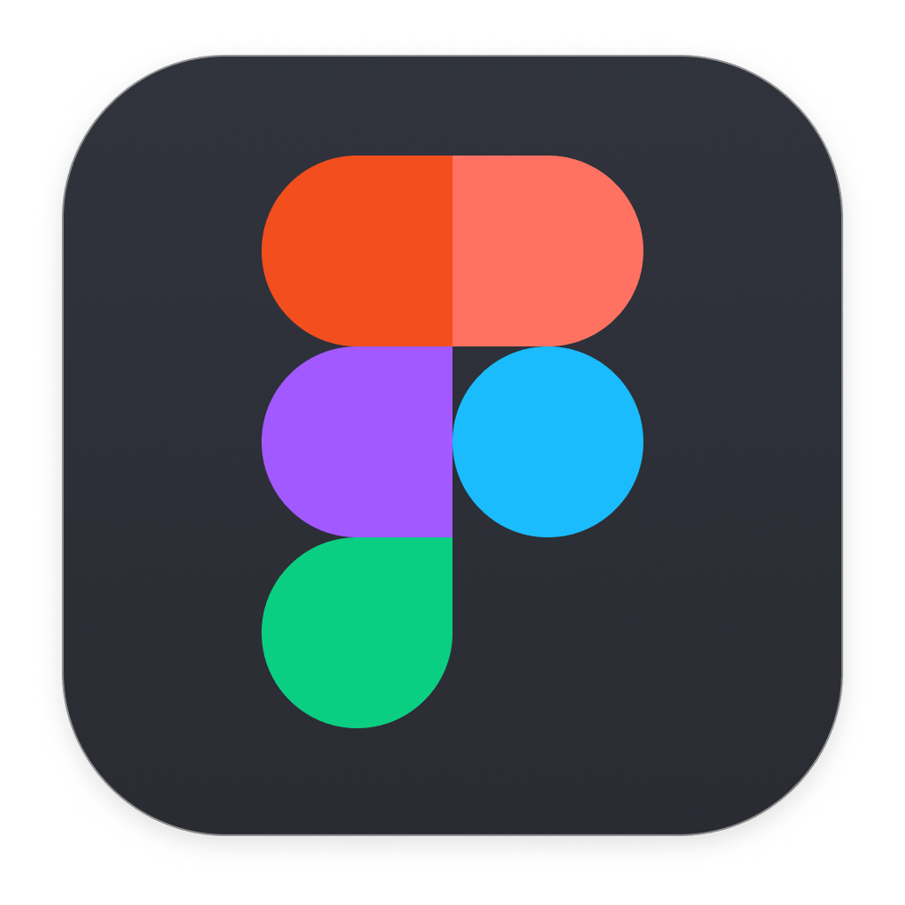
8
Appendix
Link to Prototype

